Slide 1
Analysis of Sample Source Code Test Report Generated by Coverity Tool
HARI RAMAMOORTHY M
RA(SAS), NCCS BANGALORE

Slide 2
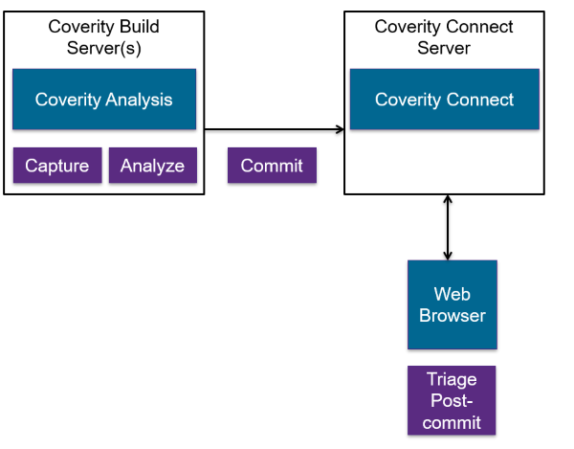
Coverity Tool Deployment :
Coverity Server
Coverity Client

Slide 3
Supported Languages by Coverity :

Slide 4
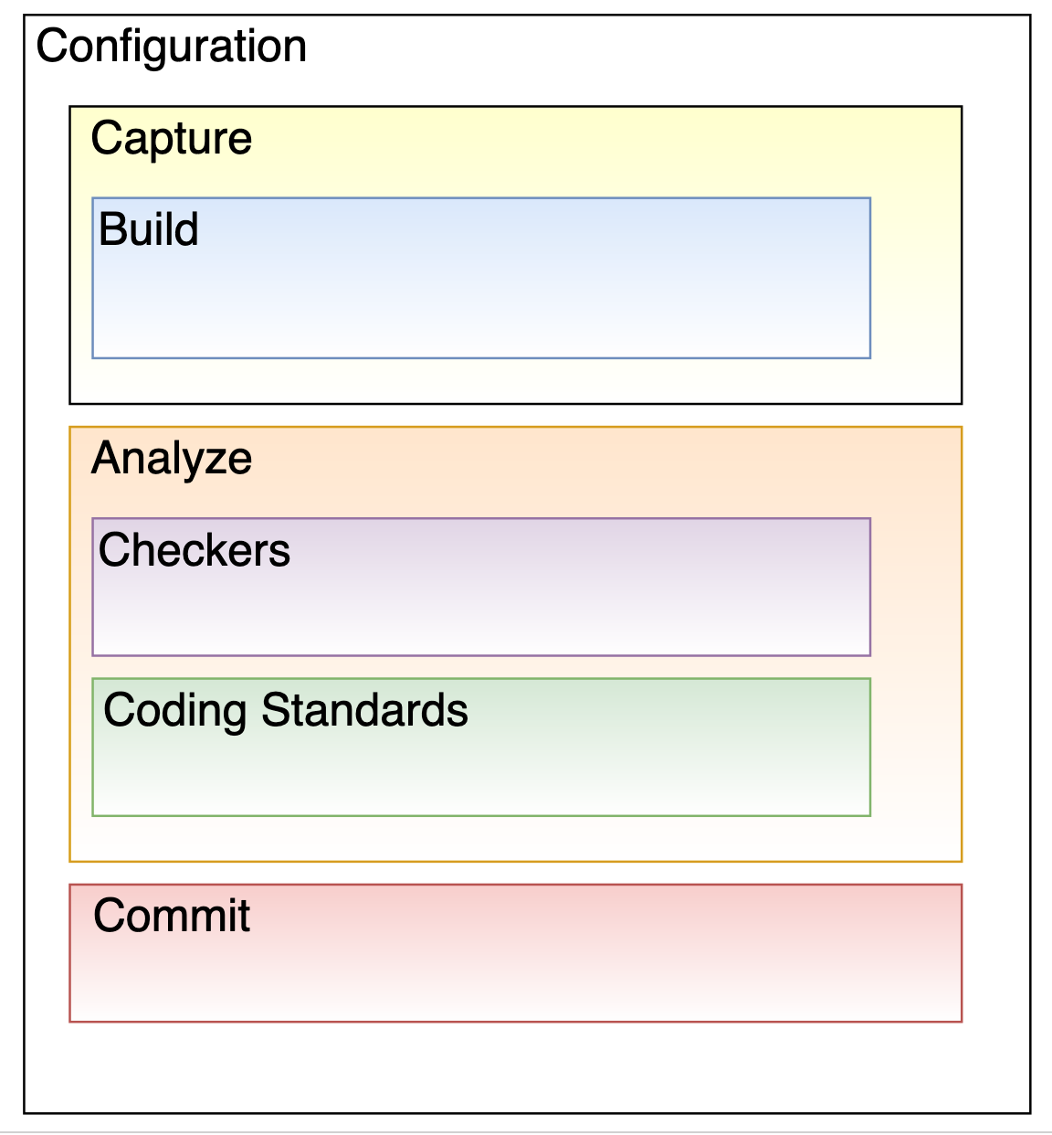
Coverity Tool Workflow :
Project Directory(cov-config)
Interpreter Based Languages(cov-capture)
Compiler Based Languages(cov-build)
Analyse the code defects(cov-analyze)
Code Checkers(BUFFER_SIZE, HARDCODED_CREDENTIALS, WEAK_PASSWORD_HASH,etc)
Code Standards(CERT-C, MISRA C,etc)
Code defects send to Coverity server(cov-commit)

Slide 5
Coverity Configuration File :
Enables the web application security related checkers like XSS, JSP_SQL_INJECTION
Enables almost all checkers that are disabled by default
Values for level are low, medium, or high. Default is low. If more aggressiveness, more false positive
Enables the security related checkers like BUFFER_SIZE
Enables the android security related checkers like ANDROID_CAPABILITY_LEAK
Enables the checker like SQL_NOT_CONSTANT
Enables the function checkers like USELESS_CALL

Slide 6
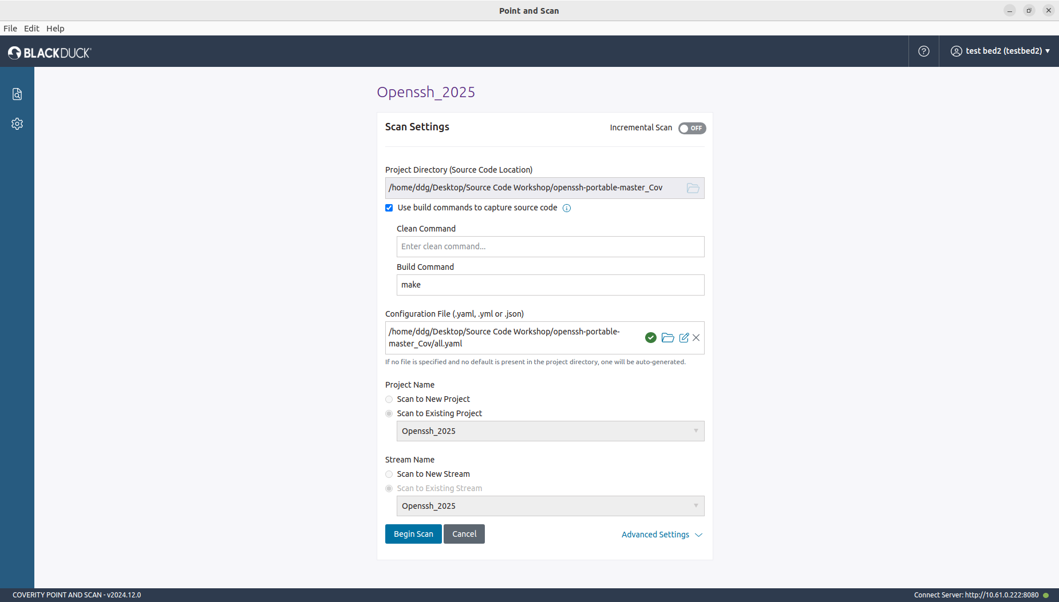
Project Source Code : OpenSSH v9.9.p2
Repo link : https://github.com/openssh/openssh-portable/archive/refs/tags/V_9_9_P2.zip
Source code language : C

Slide 7
File Count in the source directory :
Available C files = 296

Slide 8
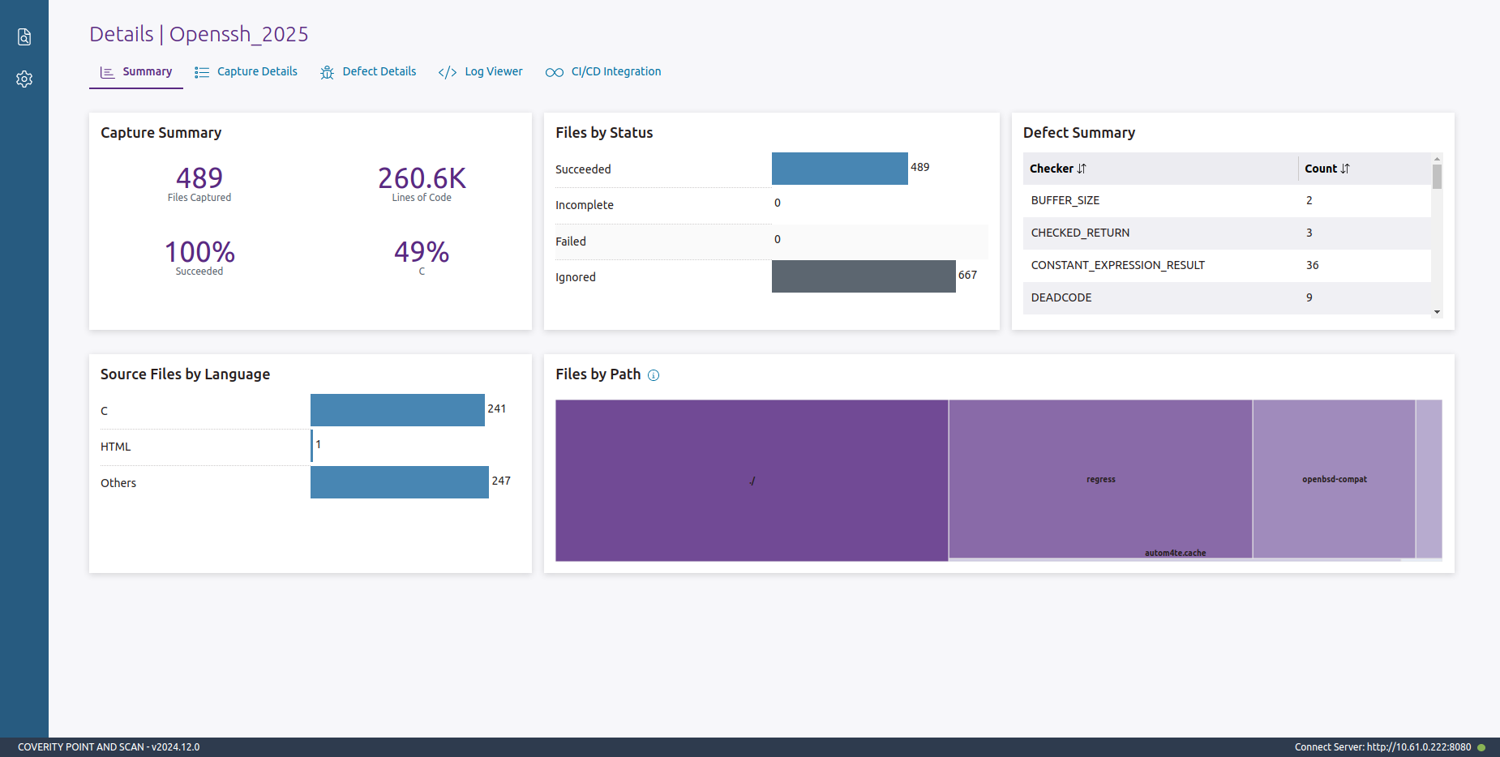
Scan summary :
Tool captured C file = 241
Difference between available c files and too captured file = 296 – 241 = 55 files are not captured

Slide 9
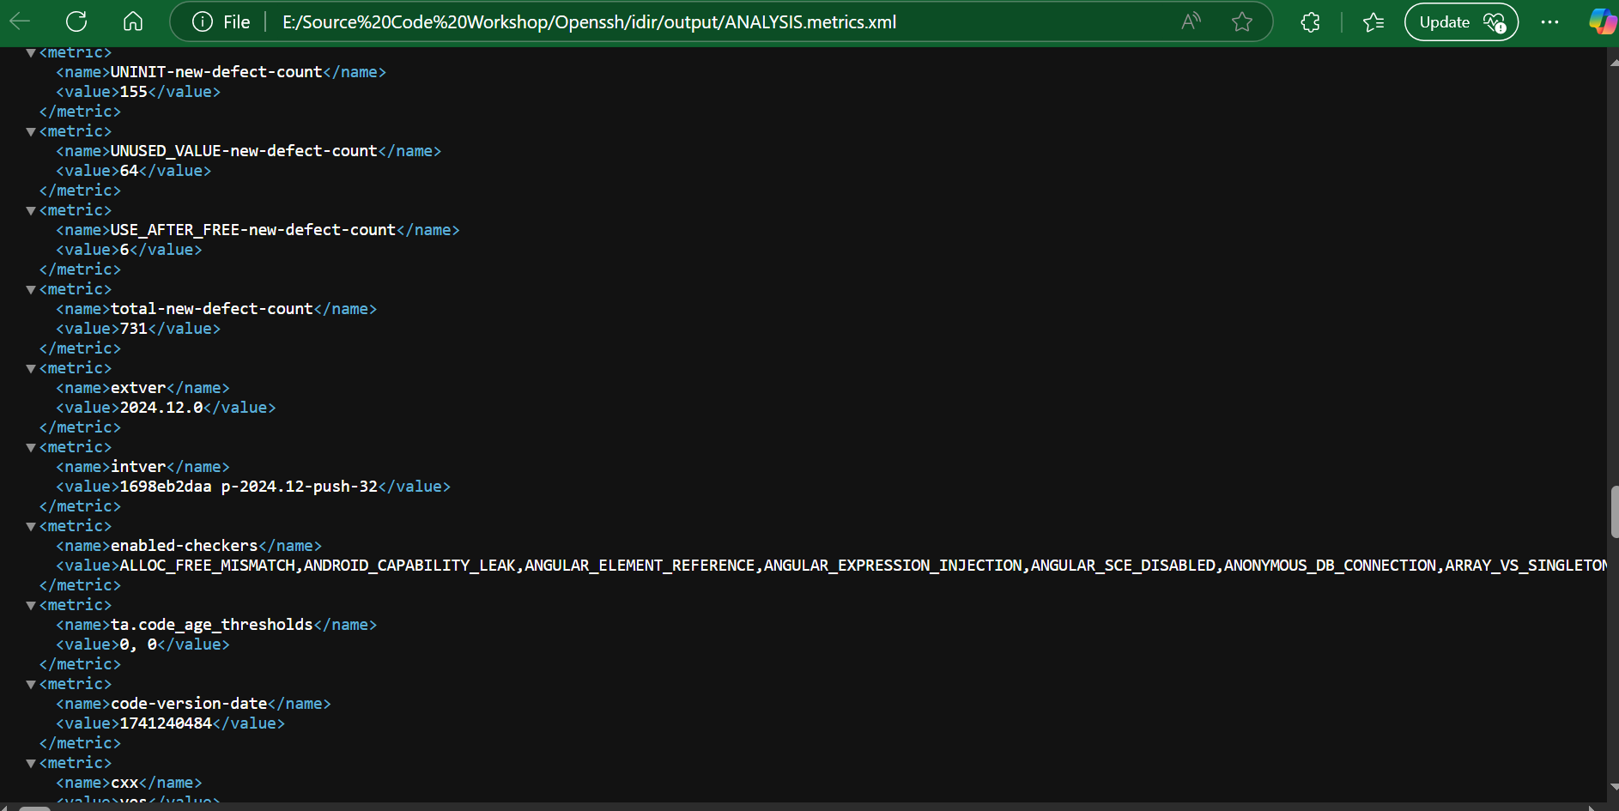
Enabled Checkers for Analysis :

Slide 10
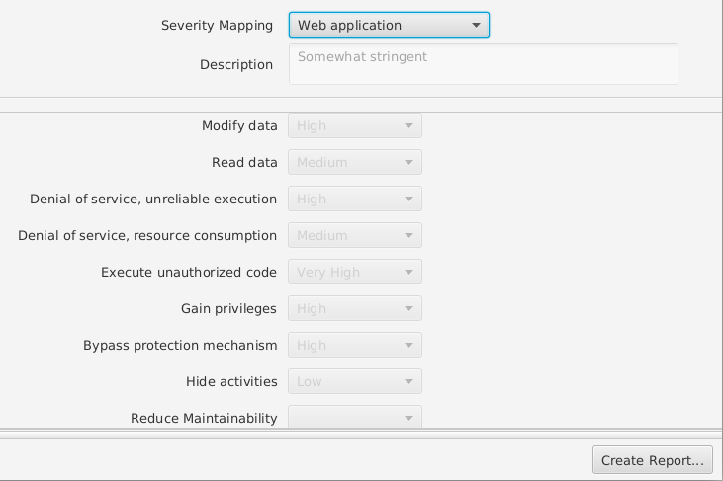
Severity Mapping :

Slide 11
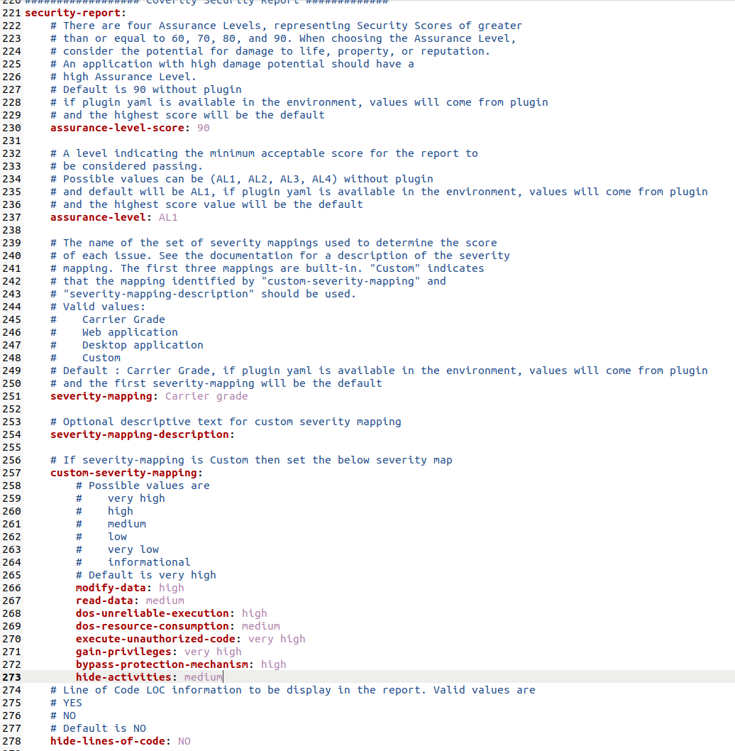
Report Generation Configuration :

Slide 12
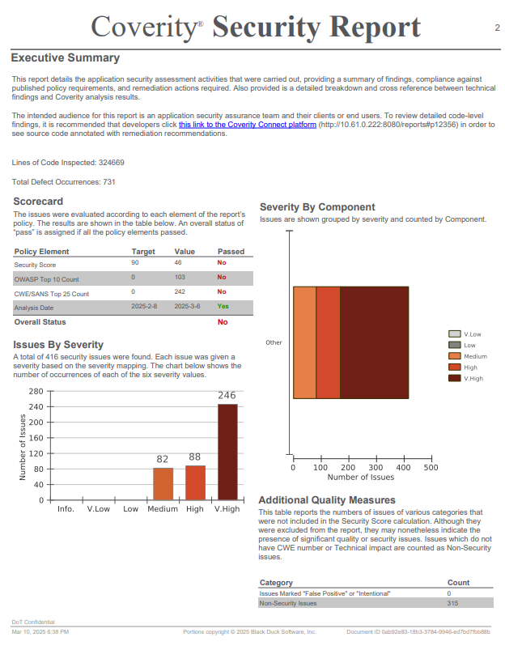
Coverity Security Report :

Slide 13
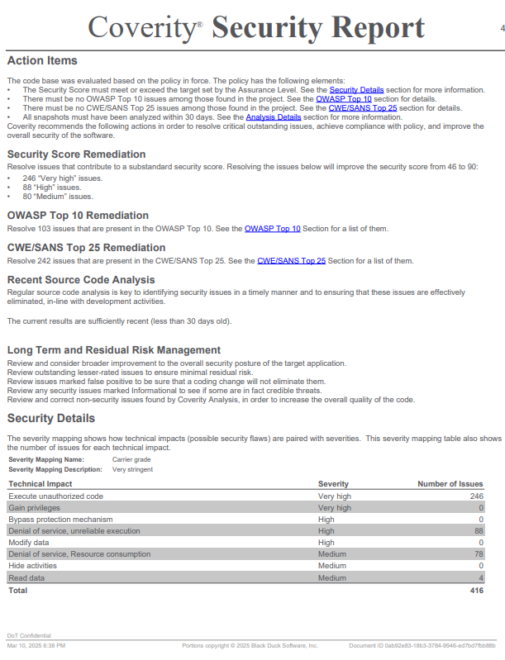

Slide 14
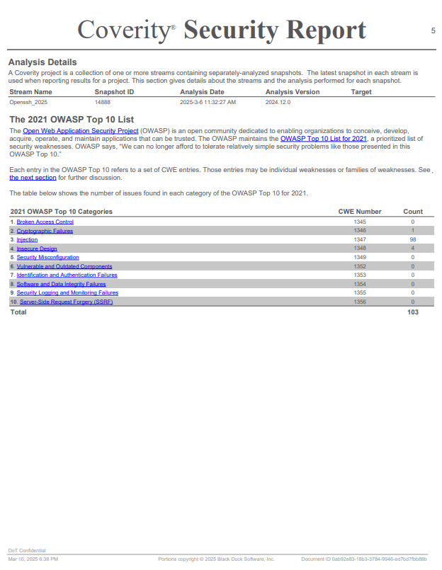

Slide 15
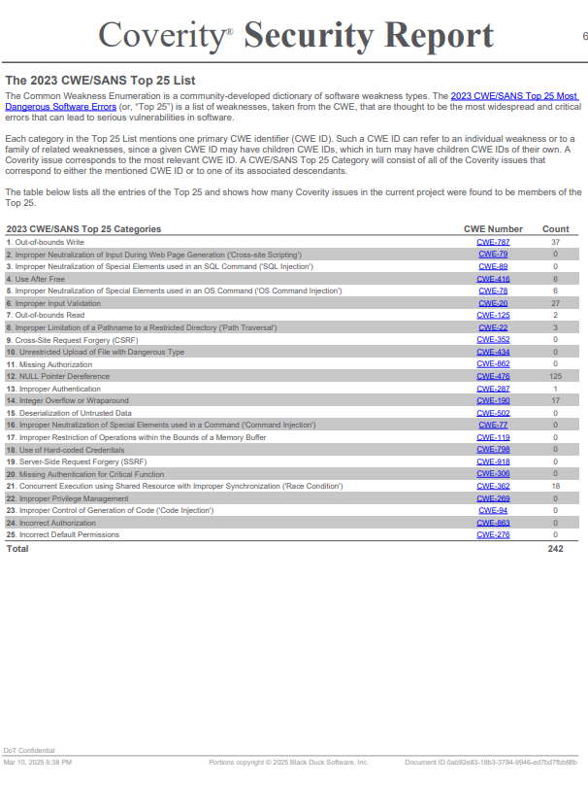

Slide 16
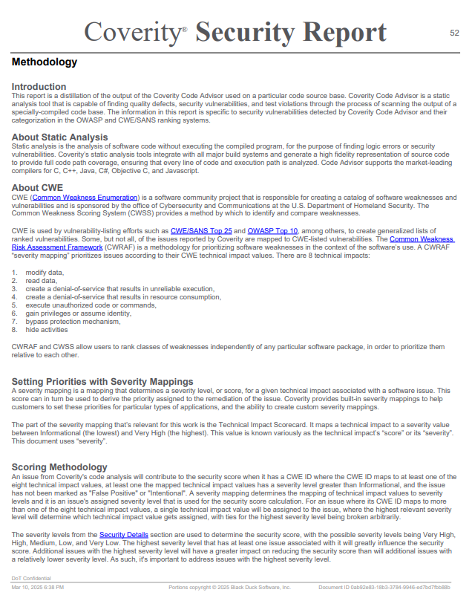

Slide 17
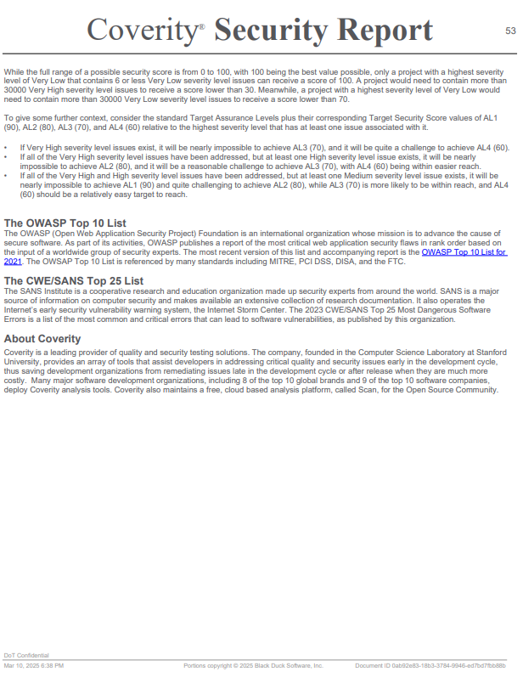

Slide 18
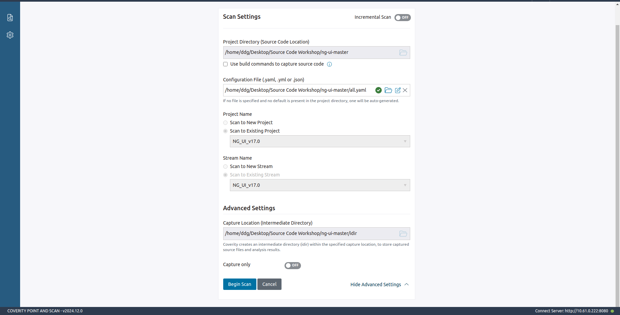
Project Source Code : Open Source MANO – NG UI v17
Repo link : https://osm.etsi.org/gitlab/osm/ng-ui/-/archive/master/ng-ui-master.zip
Source code language : Javascript, Typescript, HTML, and SCSS

Slide 19
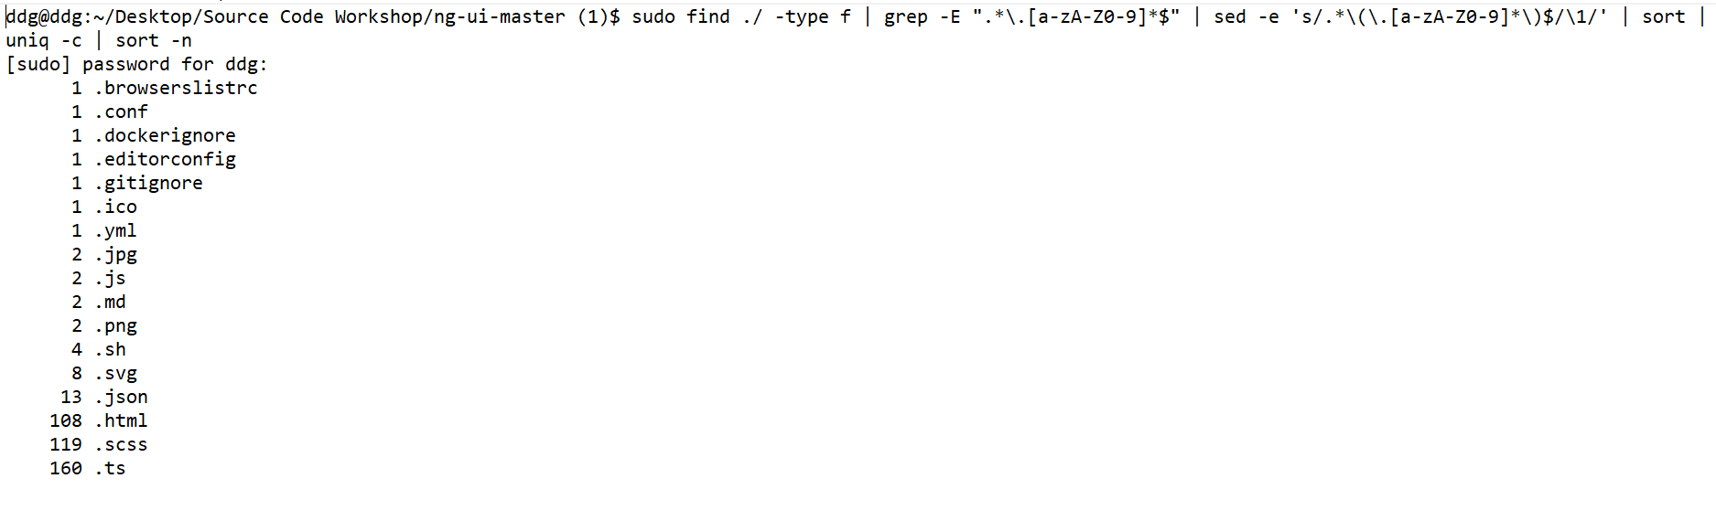
File Count in source directory :
Available type script file = 160
Available html file = 108

Slide 20
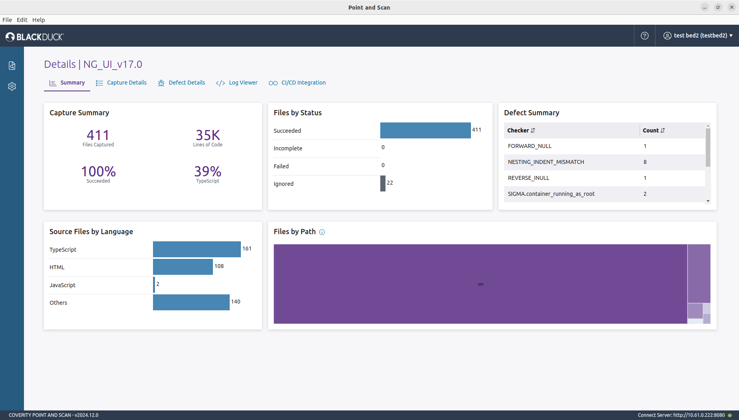
Scan summary :
Available type script file = 160
Available html file = 108
Difference between available type files and captured file(ts,html) = 0

Slide 21
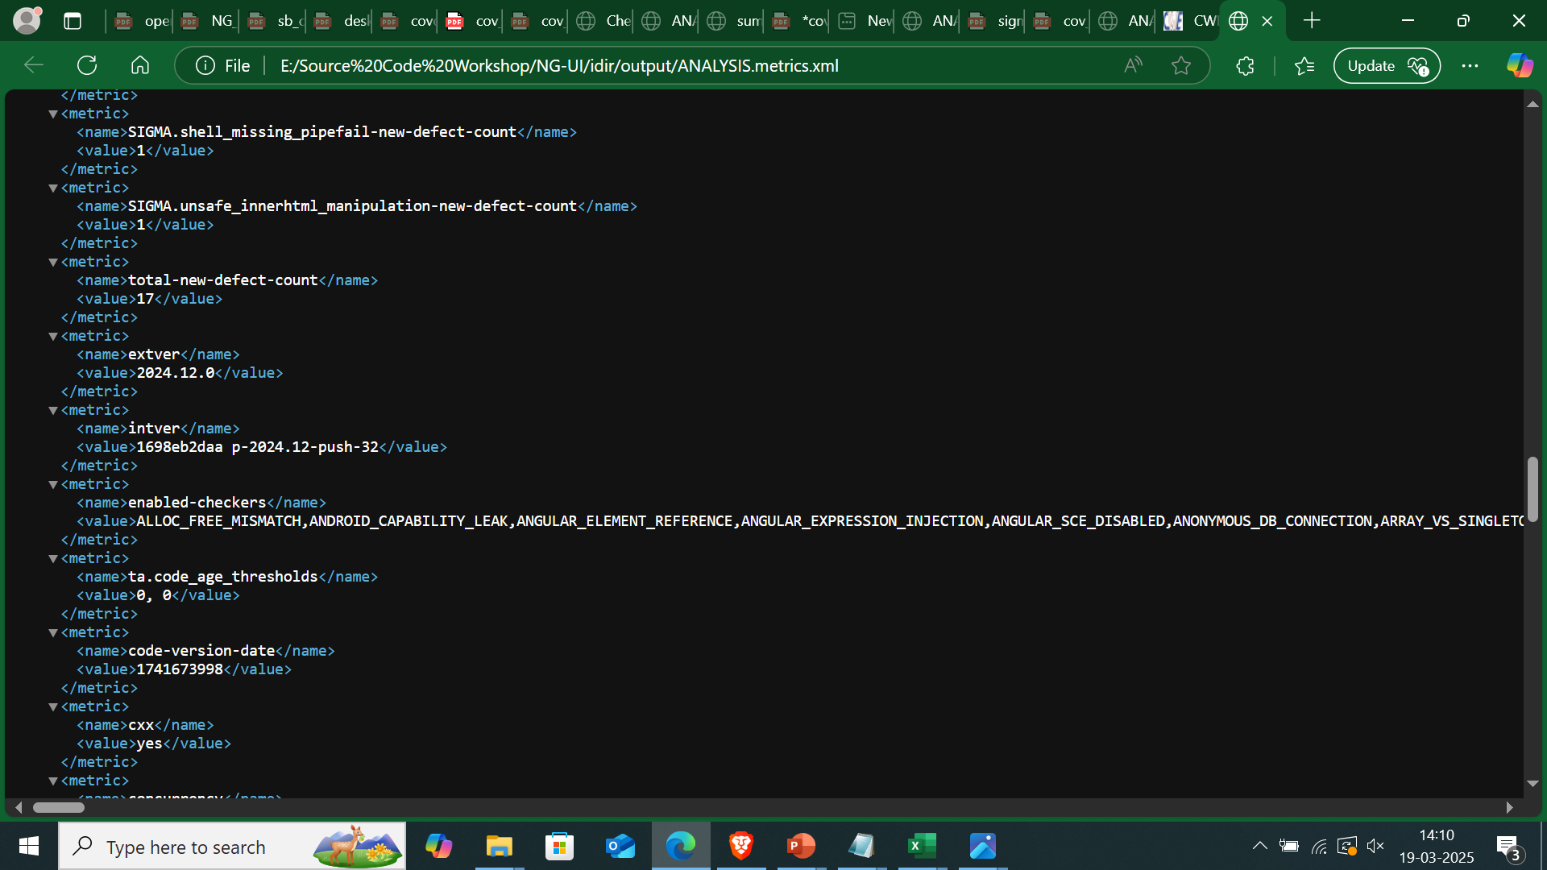
Enabled Checkers :

Slide 22
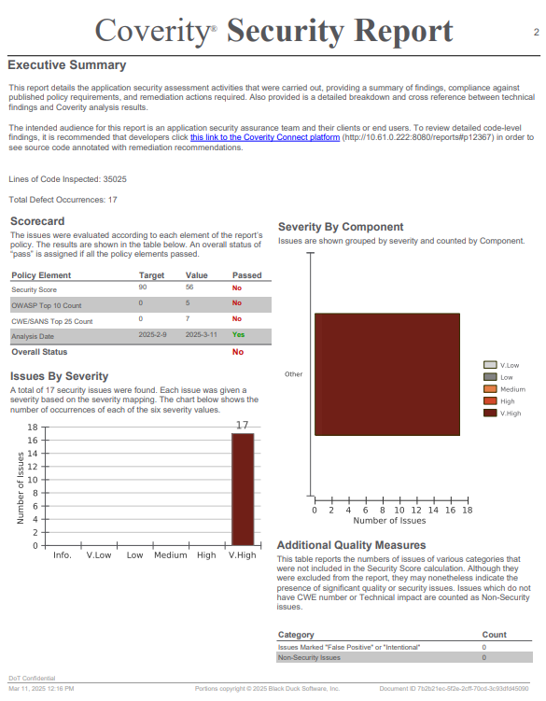
Coverity Security Report :

Slide 23
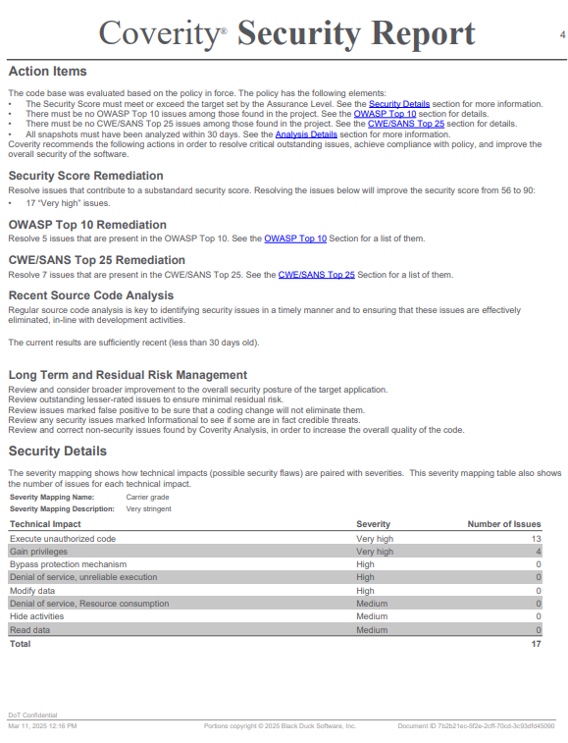

Slide 24
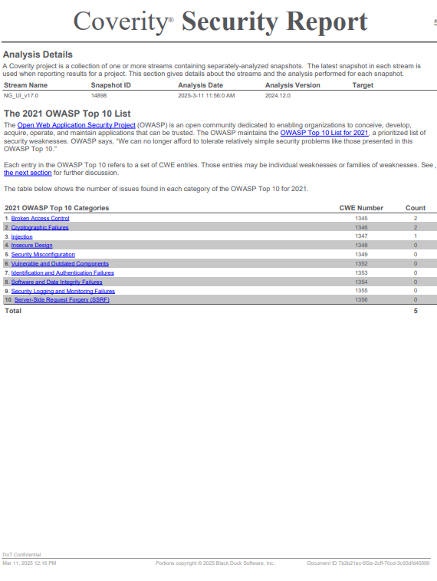

Slide 25
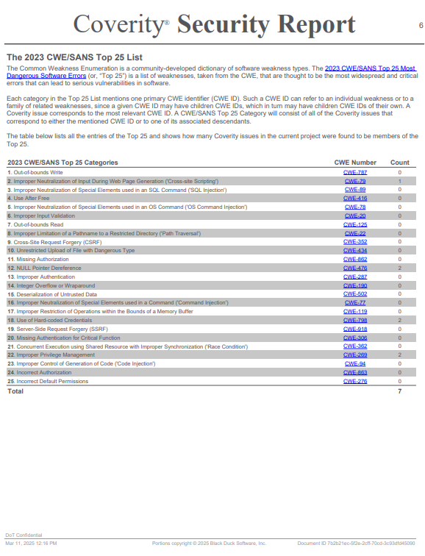

Slide 26
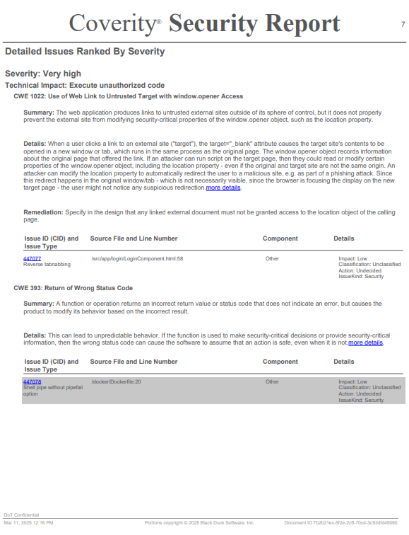

Slide 27
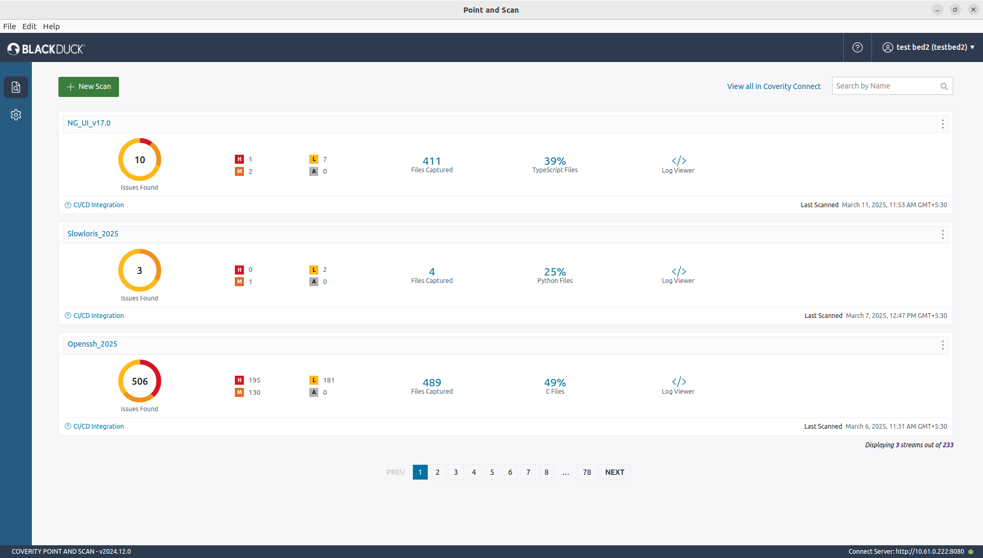
After Scan status :

Slide 28
After Scan status :

