Slide 1
ANALYSIS OF WEB SERVER RELATED TEST CLAUSES
Workshop on “Essentials of Telecom Security Testing - A tools and Testers Perspective - Part 3”
Presented by:
Riddhi Pahariya
Research Associate,
NCCS

Slide 2
Web Server
A web server is software or hardware that processes and delivers web pages, applications, and other online content to users over the internet or an intranet. It handles requests from clients (browsers) using the Hypertext Transfer Protocol (HTTP/HTTPS) and serves webpages, files, or APIs in response.

Slide 3
11.1 HTTPS
Requirement:
The communication between Web client and Web server shall be protected using industry standard secured communication protocols such as TLS/HTTPS. Cipher suites with NULL encryption shall not be supported.
Test Scenarios:
Cryptographic algorithms used in communication between the web client and web server should comply with the Cryptographic Controls specified in ITSAR.
Web server should not allow NULL encryption.
HTTPS protocol is not vulnerable to known attacks, such as the Lucky 13, Breach, sweet 32 vulnerability.
Tools Required:
TestSSL

Slide 4
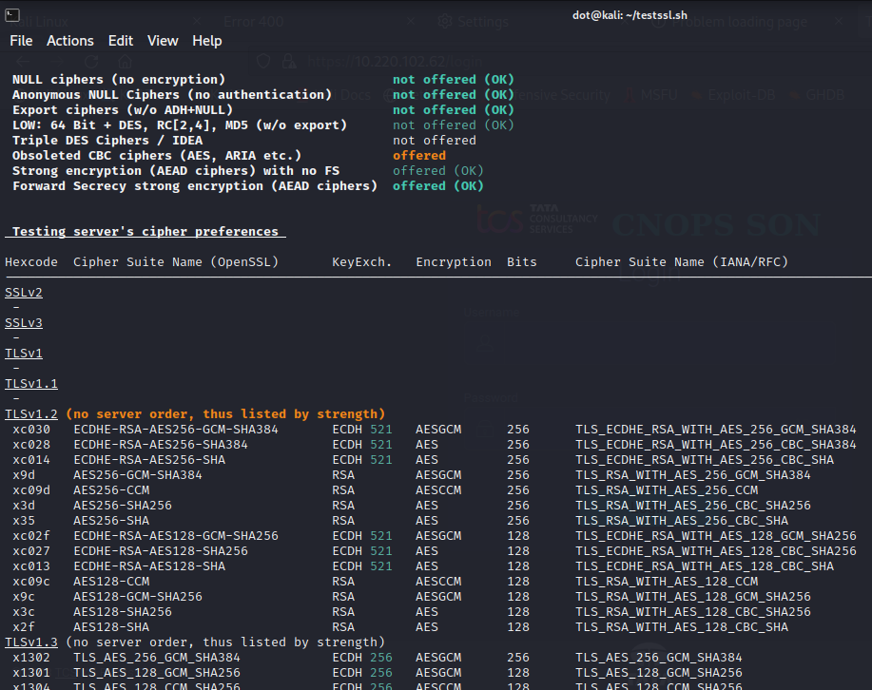

Slide 5
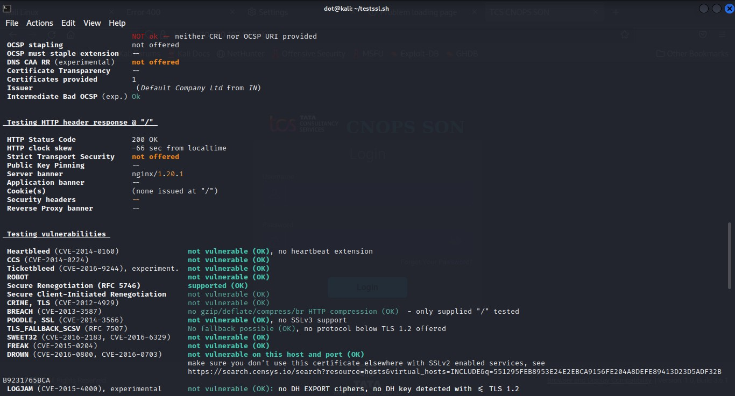

Slide 6
11.2 Webserver logging
Requirement:
Access to the webserver (both successful as well as failed attempts) shall be logged. The web server log shall contain the following information:
Access timestamp
Source (IP address)
Account (if known)
Attempted login name (if the associated account does not exist)
Relevant fields in http request. The URL should be included whenever possible.
Status code of web server response

Slide 7
11.2 Webserver logging
Test Scenarios:
Successful authentication attempt on the web page using correct credentials and verify logs.
Unsuccessful authentication attempt on the web page using incorrect credentials and verify logs.
Tools Required:
Access to log path and log files are required.

Slide 8
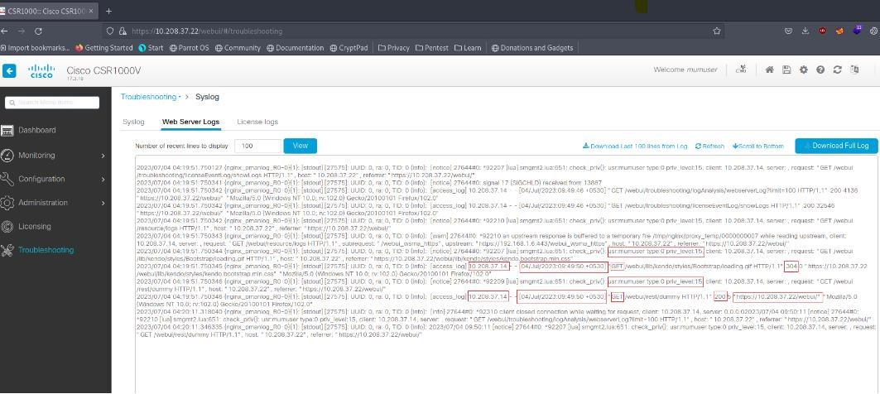
11.2 Webserver logging

Slide 9
11.3 HTTP User sessions
Requirement:
To protect user sessions the Network Product shall support the following session ID and session cookie:
(i) The session ID shall uniquely identify the user and distinguish the session from all other active sessions.
(ii) The session ID shall be unpredictable.
(iii) The session ID shall not contain sensitive information in clear text (e.g., account number, social security, etc.).
(iv) In addition to the Session Idle Timeout (see clause 1.2.5 Inactive Session Timeout), the Network Product shall automatically terminate sessions after a configurable maximum lifetime This maximum lifetime defines the maximum session span. When the maximum lifetime expires, the session shall be closed, the session ID shall be deleted, and the user shall be forced to (re)authenticate in the web application and to establish a new session. The default value for this maximum lifetime shall be set to 8 hours.
(v) Session IDs shall be regenerated for each new session (e.g. each time a user logs in)
(vi) The session ID shall not be reused or renewed in subsequent sessions.
(vii) The Network Product shall not use persistent cookies to manage sessions but only session cookies. This means that neither the "expire" nor the "max-age" attribute shall be set in the cookies.
(viii) Where session cookies are used the attribute 'Http Only' shall be set to true Where session cookies are used the 'domain' attribute shall be set to ensure that the cookie can only be sent to the specified domain.
(ix) Where session cookies are used the 'path' attribute shall be set to ensure that cookie can only be sent to the specified directory or sub-directory. The Network Product shall not accept session identifiers from GET/POST variables.
(x) The Network Product shall be configured to only accept server generate session IDs.

Slide 10
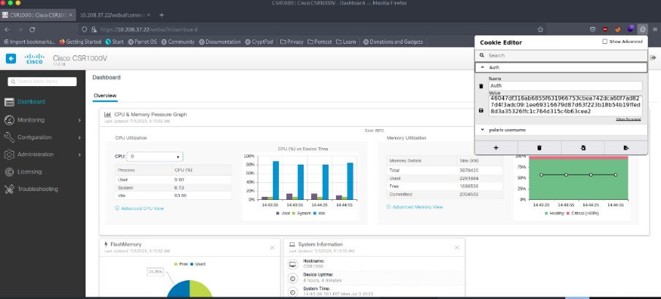
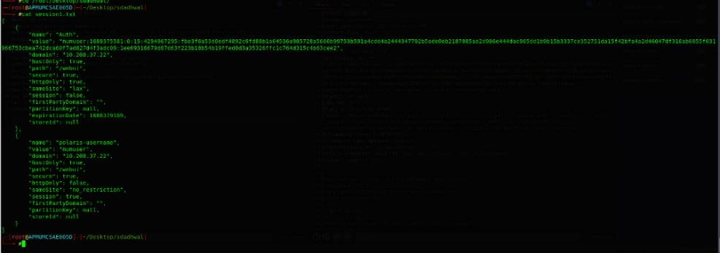
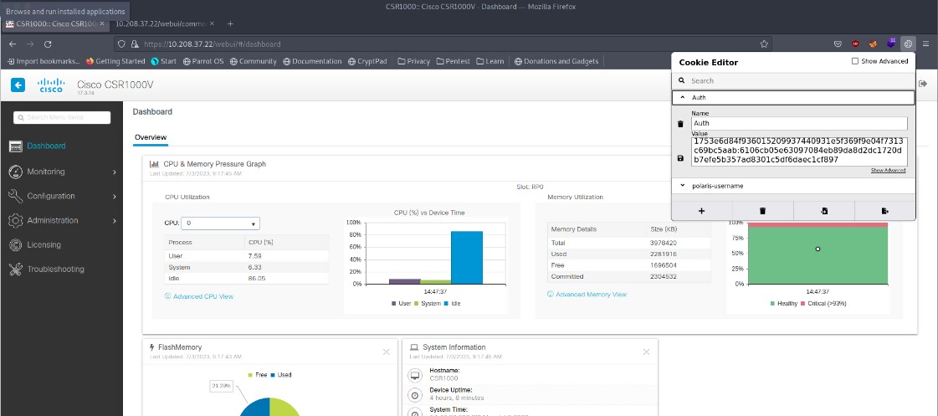
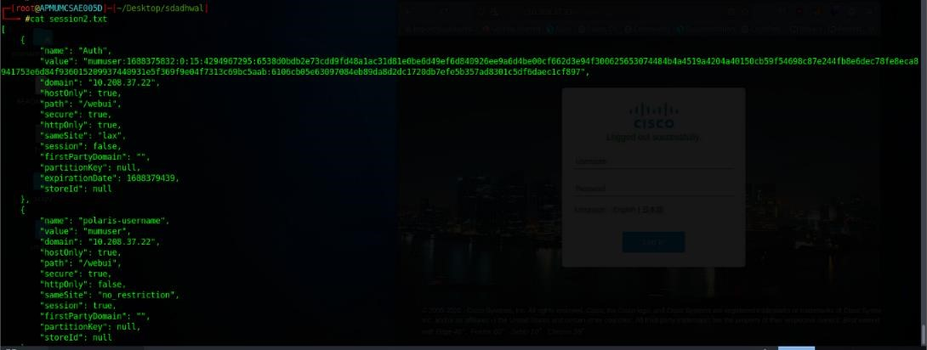
11.3 HTTP User sessions
Test Scenarios:
Each session is assigned a unique session ID that distinguishes it from other active sessions.

Slide 11
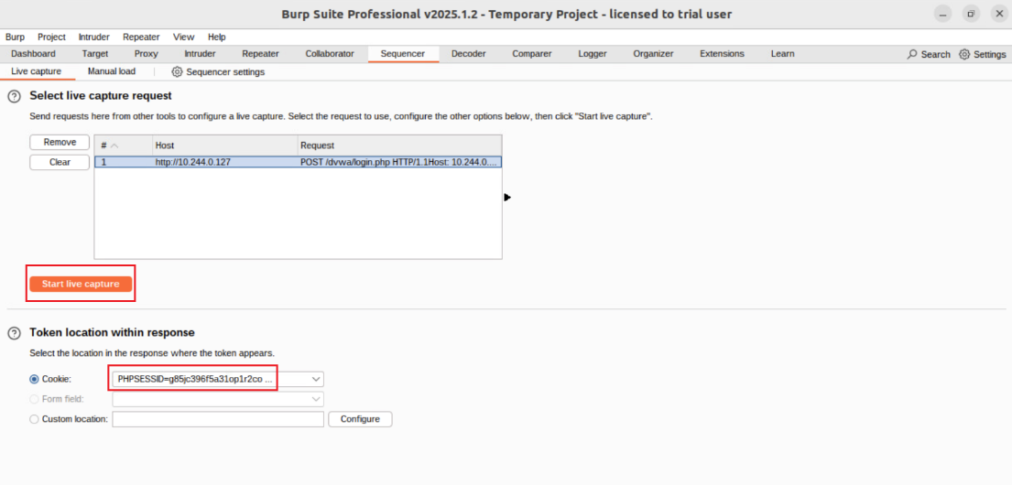
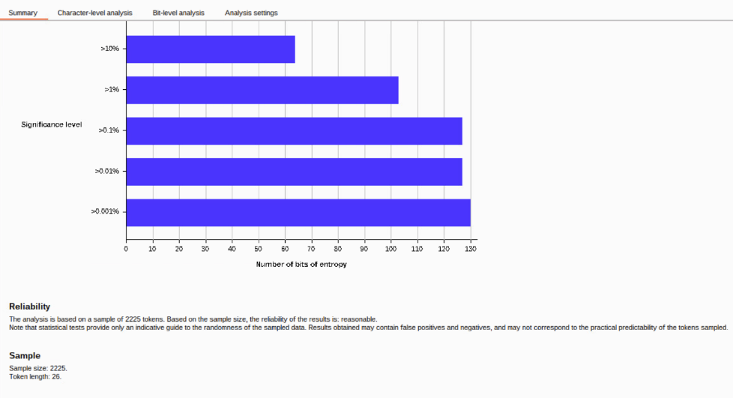
11.3 HTTP User sessions
Test Scenarios:
Session IDs are unpredictable and cannot be easily guessed.
Minimum entropy size =64(As per OWASP current reference)

Slide 12
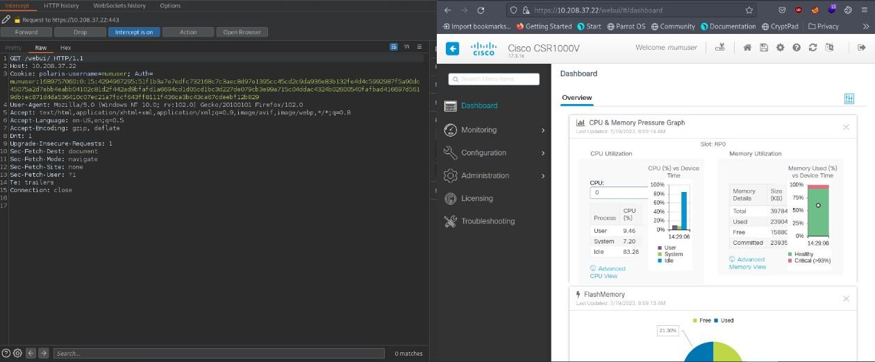
11.3 HTTP User sessions
Test Scenarios:
Test Scenario to verify that session ID doesn’t contain the sensitive information in clear text.
Capture request in burpsuite to verify if any confidential information is revealed

Slide 13
11.3 HTTP User sessions
Test Scenarios:
Test Scenario - Sessions are automatically terminated after the configured maximum session lifetime.
Tester will login DUT and capture session ID and wait for OEM configured maximum session lifetime. Further tester will attempt DUT login with same session ID to verify if session is still logged in (new login page didn’t appeared)or either new login page/error page appeared.
This can verified either through GUI session expiry or through session logs.
This is OEM dependent case, Maximum session lifetime must be declared by the OEM

Slide 14
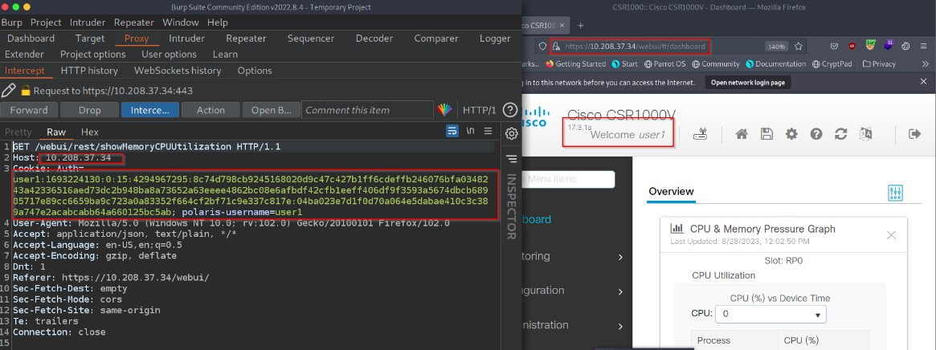
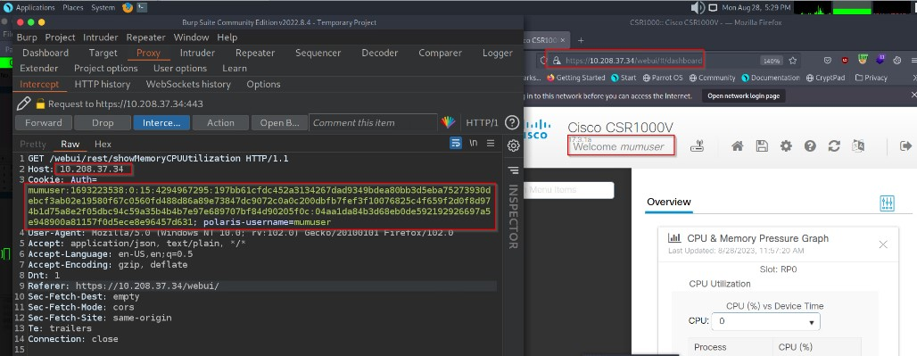
11.3 HTTP User sessions
Test Scenarios:
5. For every new login, the new session ID is regenerated.
Login by user1
Login by user2

Slide 15
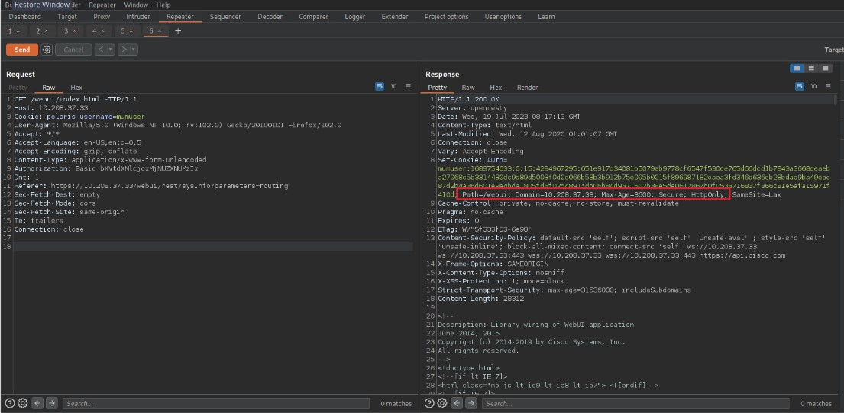
11.3 HTTP User sessions
Test Scenarios:
The network product uses only session cookies and does not use persistent cookies to manage sessions.
Max Age should not be configured.

Slide 16
11.3 HTTP User sessions
Test Scenarios:
The session cookie has secure attributes like HttpOnly, path, and domain set correctly.

Slide 17
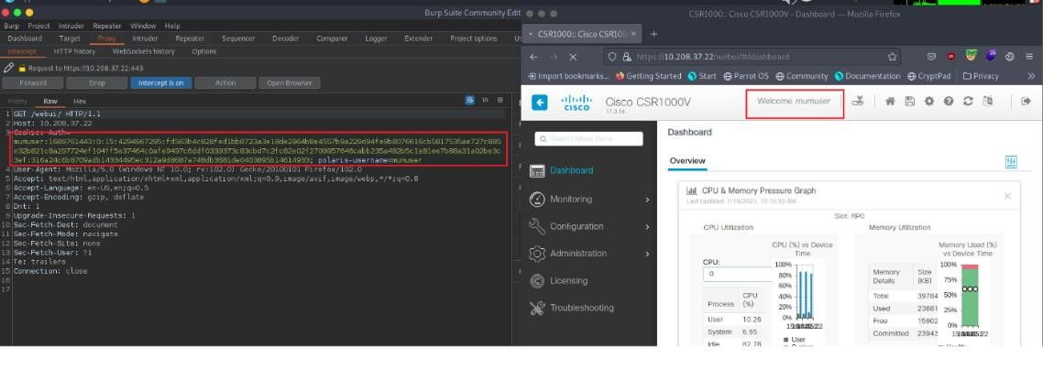
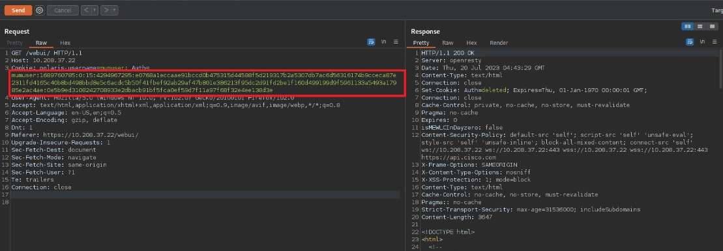
11.3 HTTP User sessions
Test Scenarios:
Session IDs are not passed through GET or POST variables and are only accepted via web server-generated session IDs.
when we used the same session ID and we changed that HTTP method from GET to POST, web application automatically logged out and session was terminated.

Slide 18
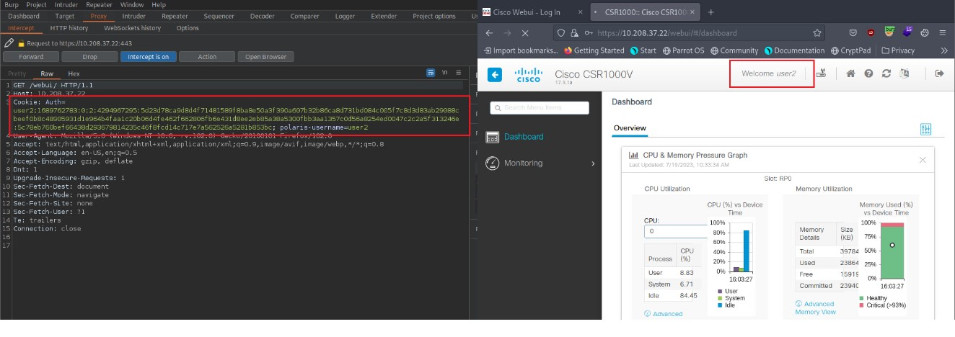

Slide 19
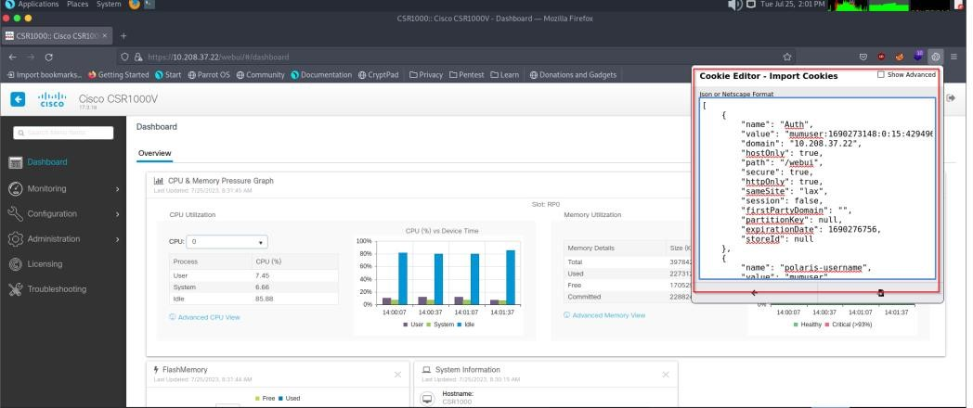
11.3 HTTP User sessions
Test Scenarios:
Session ID shall not be reused or renewed in subsequent sessions.
Initial Session ID
Reuse Session ID (import cookie of last session)
Redirected to the login page

Slide 20
11.4 HTTP input validation
Requirement:
The Network Product shall have a mechanism in place to ensure that web application inputs are not vulnerable to command injection or cross-site scripting attacks. The Network Product shall validate, filter, escape, and encode user-controllable input before it is placed in output that is used as a web page that is served to other users.
Test Scenarios:
Test case to verify that all the input fields in the WEB Application is free from XSS attack.
Test case to verify that all the input fields in the WEB Application is free from Command Injection attack.
Tools Used :
Crawl (for scripting attack)
Commix (command Injection attack)

Slide 21
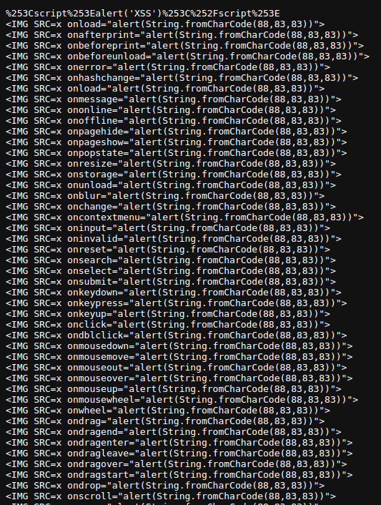
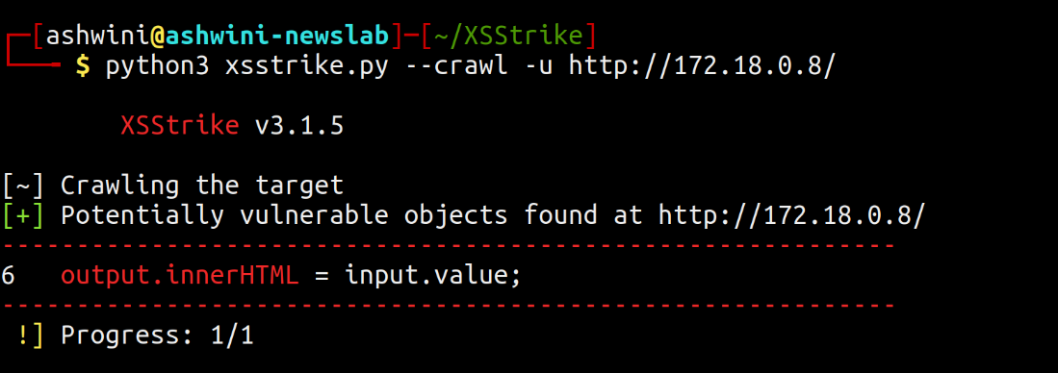
11.4 HTTP input validation
Automated approach
XSS Payload (Manual approach)

Slide 22
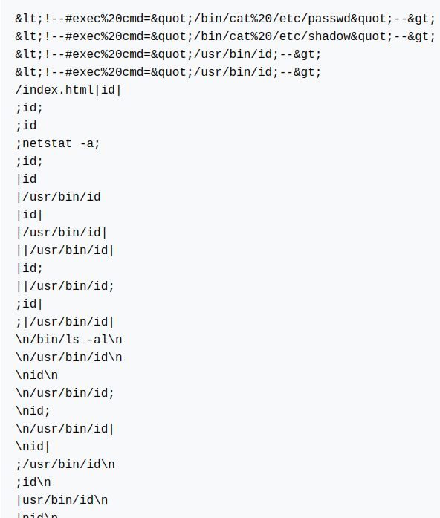
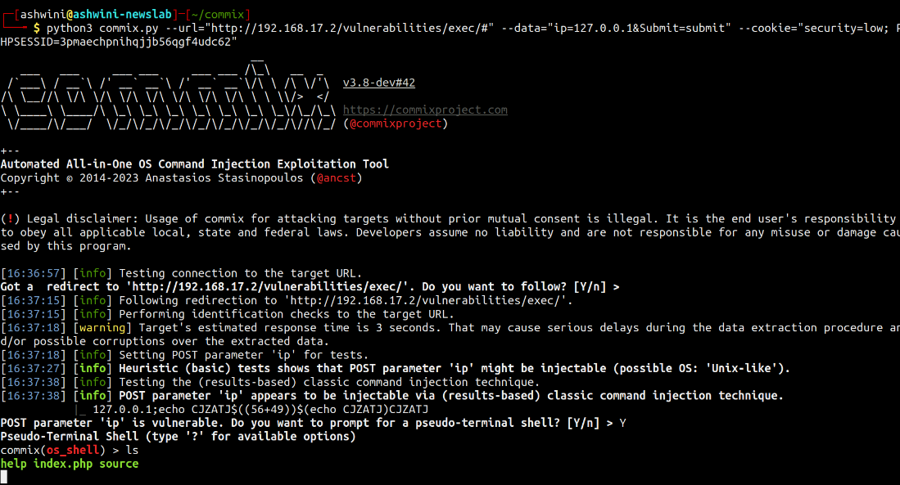
11.4 HTTP input validation
Automated approach
Command Injection Payload (manual)

Slide 23
11.5 No system privileges
Requirement:
No web server processes shall run with system privileges. This is best achieved if the web server runs under an account that has minimum privileges. If a process is started by a user with system privileges, execution shall be transferred to a different user without system privileges after the start.
Test Scenarios:
Web server process is not running under root or system level privileges - check the user account under which the web server is operating.

Slide 24
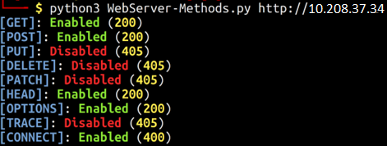
11.6 No unused HTTP methods
Requirement:
The HTTP methods that are not required shall be deactivated. Standard requests to web servers only use GET, HEAD, and POST. If other methods are required, they shall not introduce security leaks such as TRACK or TRACE.
Test Scenarios:
Only GET, HEAD, and POST methods are allowed on the web server unless other methods are explicitly required.

Slide 25
11.7 No unused add-ons
Requirement:
All optional add-ons and components of the web server shall be deactivated if they are not required. In particular, CGI or other scripting components, Server Side Includes (SSI), and WebDAV shall be deactivated if they are not required.
Test Scenarios:
Any optional components (e.g., scripting modules like PHP, Python, CGI, WebDAV,SSI, plugins) are disabled unless documented as necessary by the OEM.

Slide 26
11.8 No compiler, interpreter, or shell via CGI or other server- side scripting
Requirement:
If CGI (Common Gateway Interface) or other scripting technology is used, the CGI directory - or other corresponding scripting directory - shall not include compilers or interpreters (e.g., PERL interpreter, PHP interpreter/compiler, Tcl interpreter/compiler or operating system shells).
Test Scenarios:
No compilers or interpreters (e.g., PERL interpreter, PHP interpreter/compiler, Tcl interpreter/compiler, or operating system shells) are present in the CGI or scripting directory.

Slide 27
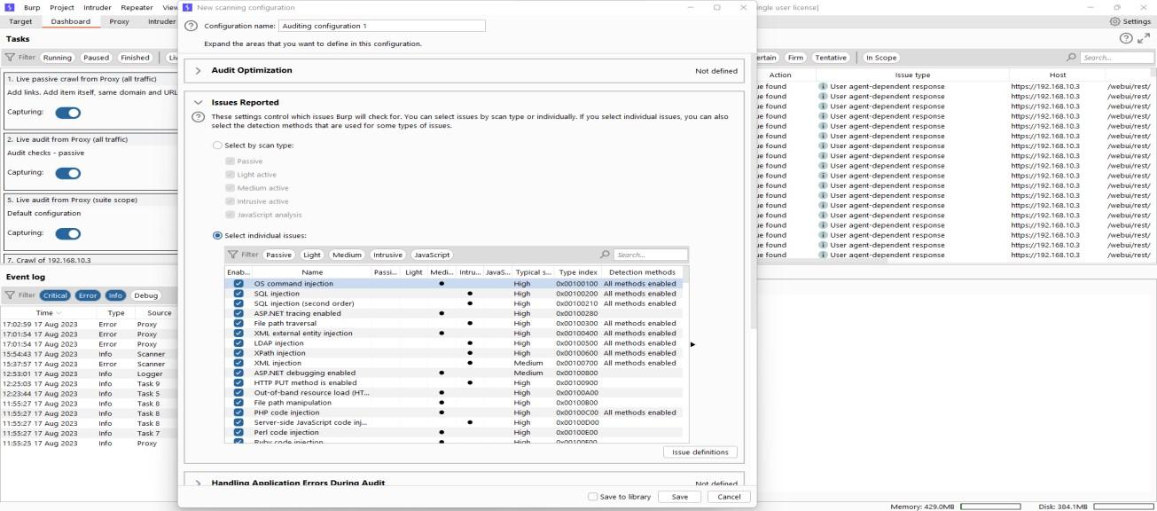
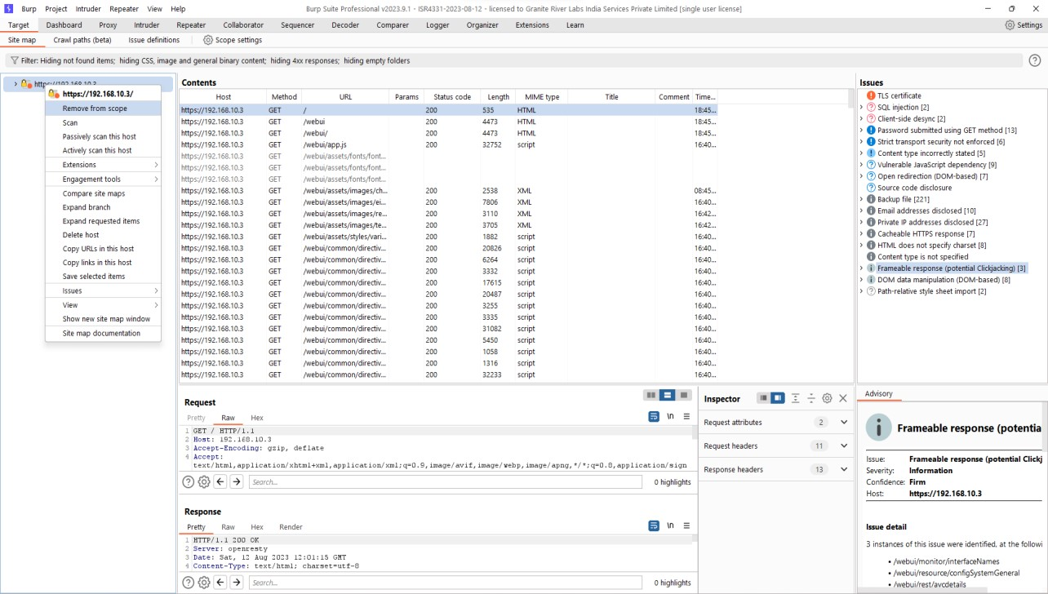
11.8 No compiler, interpreter, or shell via CGI or other server- side scripting
Configure Burp Suite
There is no compiler, interpreter, or shell via CGI or other server-side scripting installed on DUT

Slide 28
11.9 No CGI or other scripting for uploads
Requirement:
If CGI or other scripting technology is used, the associated CGI/script directory shall not be used for uploads.
Test Scenarios:
Upload a file to the specified Upload directory and verify that the file is successfully uploaded in the directory provided by the OEM.
Upload directory is configured to be separate from the CGI/scripting directory, ensuring that uploads do not occur in the CGI/scripting directory.
The web server should not have write permissions for the CGI/scripting directory to prevent unauthorized uploads.

Slide 29
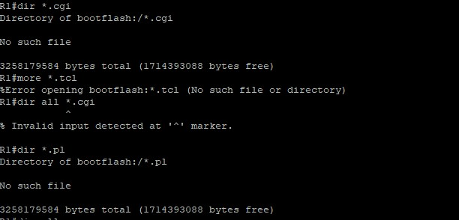
11.9 No CGI or other scripting for uploads
Tester tried to search .cgi files to check if any CGI or other scripting is being used for uploading.

Slide 30
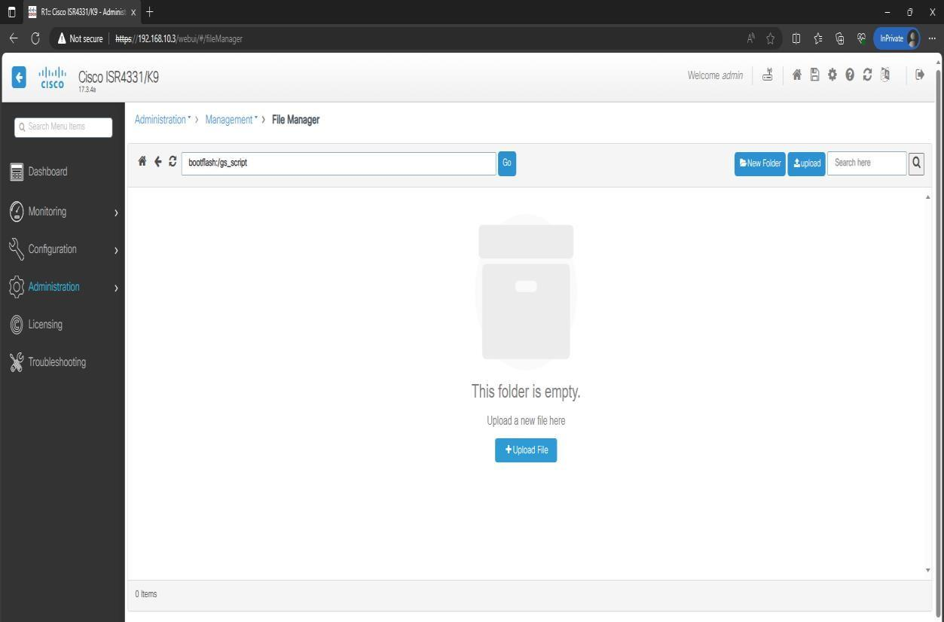
11.9 No CGI or other scripting for uploads
Tester tried to upload one file from test machine to check if any CGI or other scripting is being used for uploading.

Slide 31
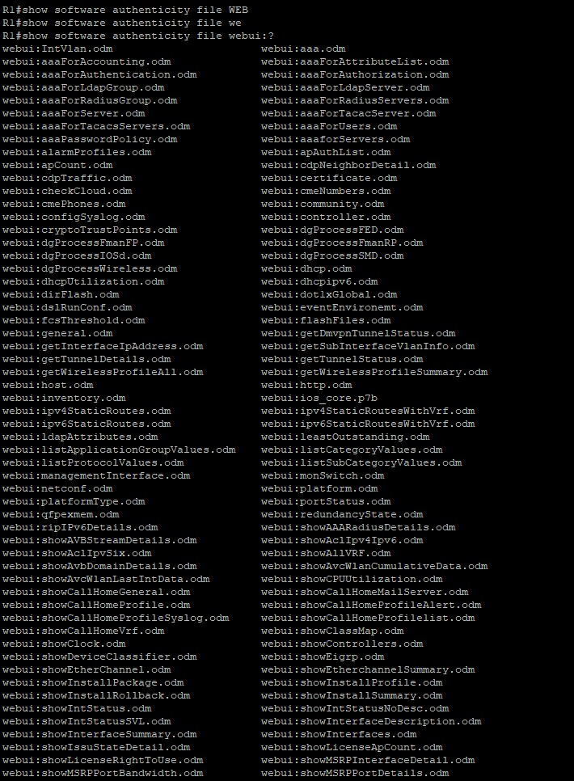
11.10 No execution of system commands with SSI Requirement
Requirement:
If Server Side Includes (SSI) is active, the execution of system commands shall be deactivated.
Test Scenarios:
Test case to actually attempt to use the exec directive in an SSI file with and without system commands.
Tools Required:
Tester will access log path and log files.

Slide 32
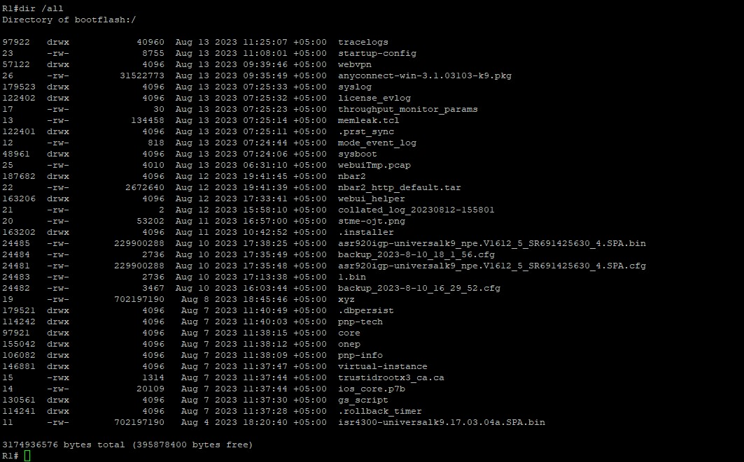
11.11 Access rights for web server configuration
Requirement:
Access rights for web server configuration files shall only be granted to the owner of the web server process or to a user with system privileges. Implementation example: Delete "read" and "write" access rights for "others." Only grant "write" access to the user who configures the web server.
Test Scenarios:
Access Rights for Web Server Configuration Files is not available to unprivileged user.
Tools Required:
Tester will access log path and log files.

Slide 33
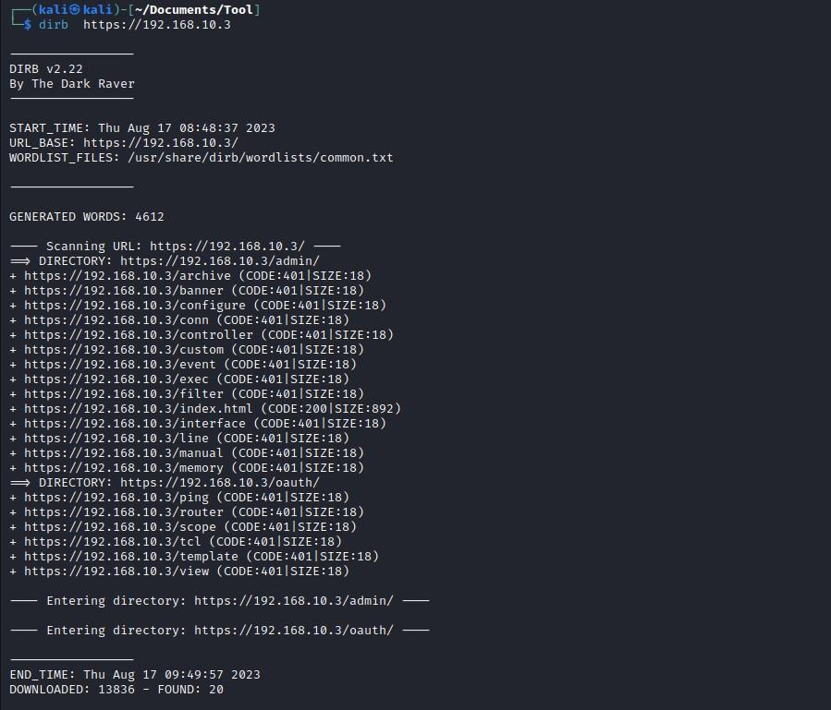
11.12 No default content
Requirement:
Default content (examples, help files, documentation, aliases) that is provided with the standard installation of the web server shall be removed.
Test Scenarios:
Root directory and all accessible directories do not contain any default content.
Tools Required:
Tester will access log path and log files.

Slide 34
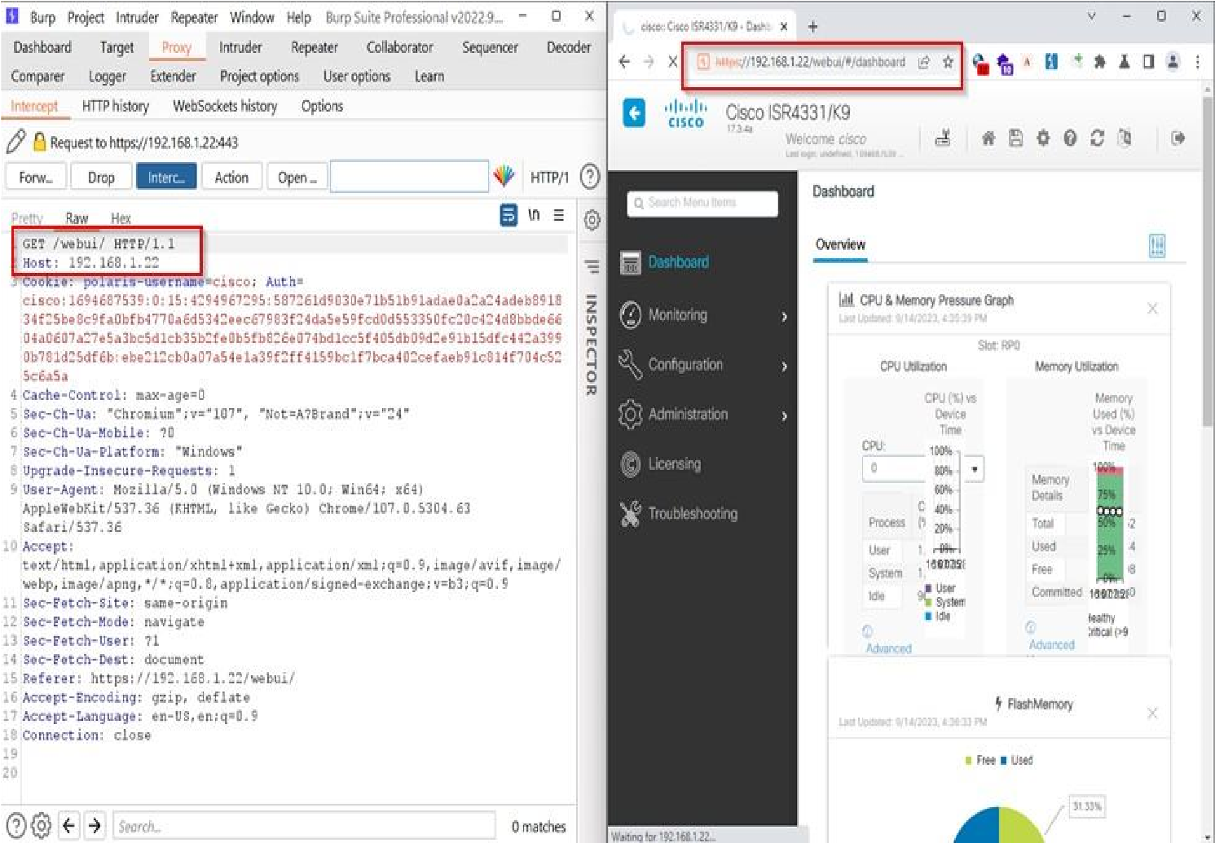
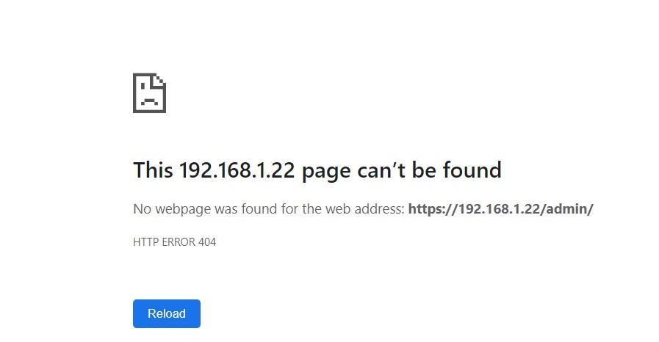
11.13 No directory listings
Requirement:
Directory listings (indexing) / "Directory browsing" shall be deactivated.
Test Scenarios:
Directory Browsing is Disabled in configuration.
Directory Browsing not possible through web server.
Using Burpsuite

Slide 35
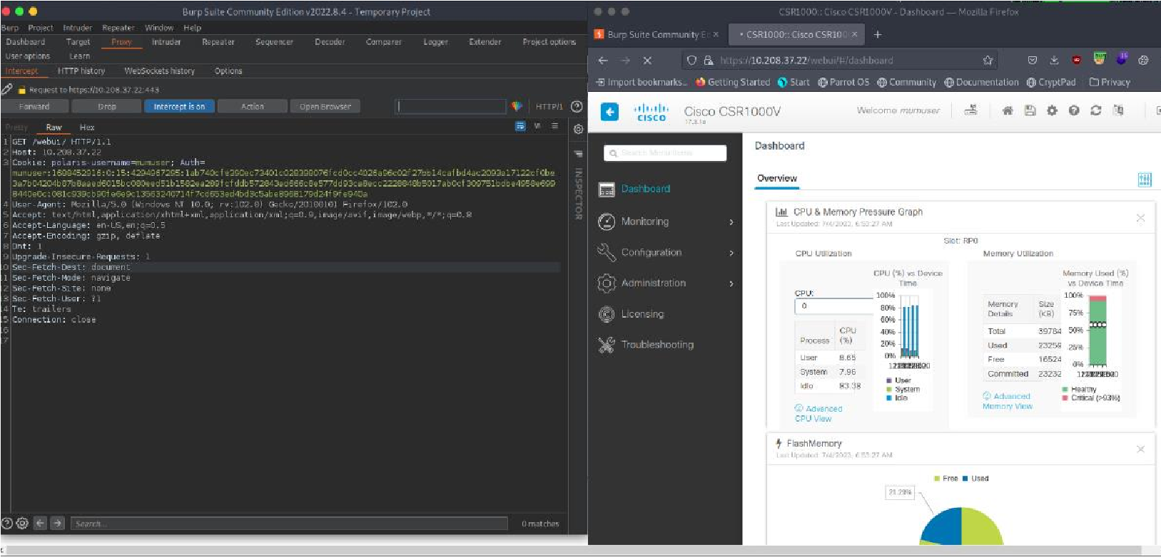
11.14 Web server information in HTTP headers
Requirement:
The HTTP header shall not include information on the version of the web server and the modules/add-ons used.
Test Scenarios:
The web server is configured to suppress version information and modules/add-ons information in response headers.

Slide 36
11.15 Web server information in error pages
Requirement:
User-defined error pages shall not include version information about the web server and the modules/add-ons used. Error messages shall not include internal information such as internal server names, error codes, etc. Default error pages of the web server shall be replaced by error pages defined by the vendor.
Test Scenarios:
1: Test case to verify that default error pages are available in DUT and not disclose version information or internal information.
2: Test case to trigger an error on the web server and confirms that user-defined error pages and error messages do not disclose version information or internal information.
Tools Required:
Tester will access log path and log files.

Slide 37
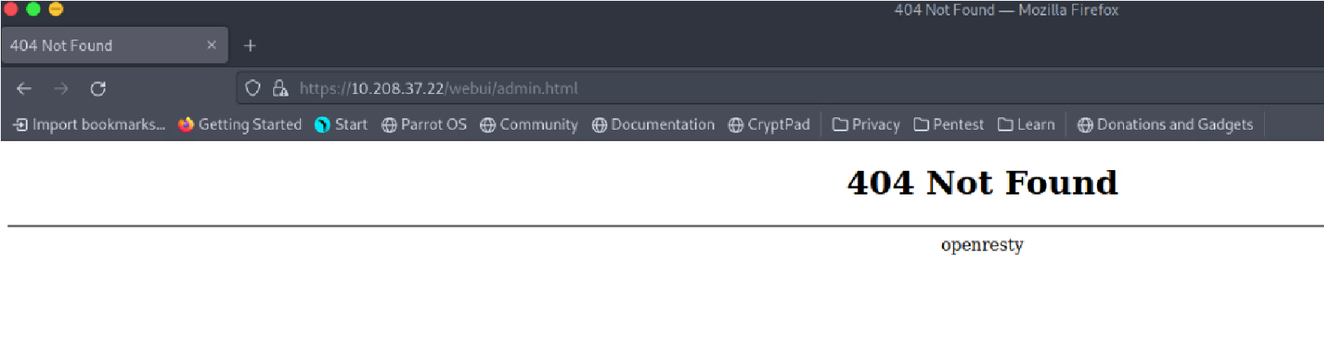
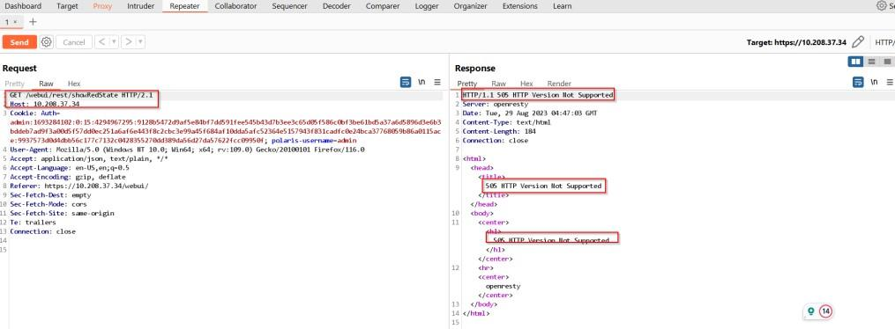
11.15 Web server information in error pages
Check error page in browser
Check response in burpsuite(information is disclosed)

Slide 38
11.16 Minimized file type mappings
Requirement:
File type- or script-mappings that are not required shall be deleted, e.g. php, phtml, js, sh, csh, bin, exe, pl, vbe, vbs.
Test Scenarios:
Unused mappings, based on the OEM provided list of file types, should be deleted.

Slide 39
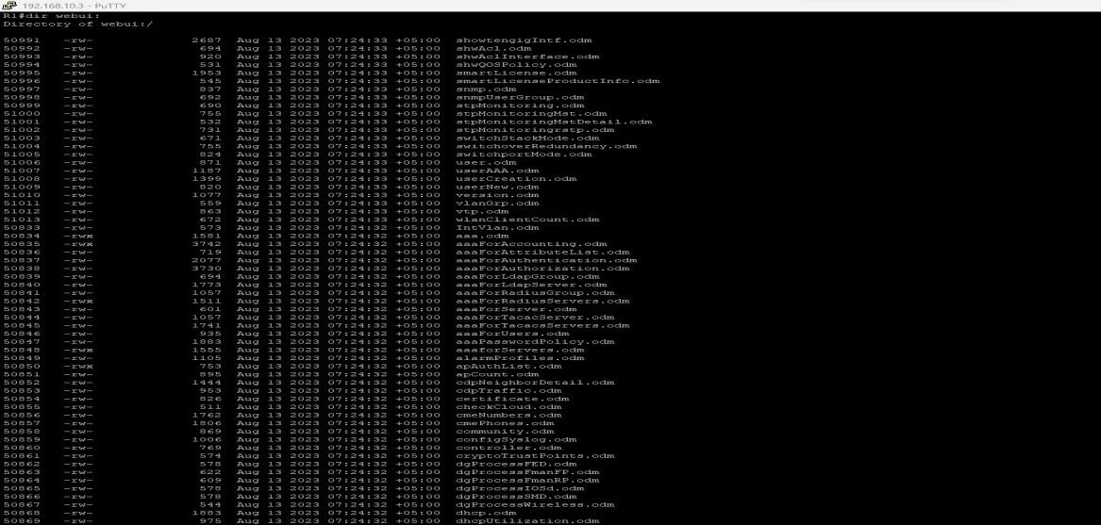
11.17 Restricted file access
Requirement:
Restrictive access rights shall be assigned to all files which are directly or indirectly (e.g., via links or in virtual directories) in the web server's document directory. In particular, the web server shall not be able to access files which are not meant to be delivered.
Test Scenarios:
Default access rights for files in the web server's document directory are restrictive.
Any new files added to the document directory automatically receive restrictive access rights.
Attempt to access files outside the document directory through path traversal

Slide 40
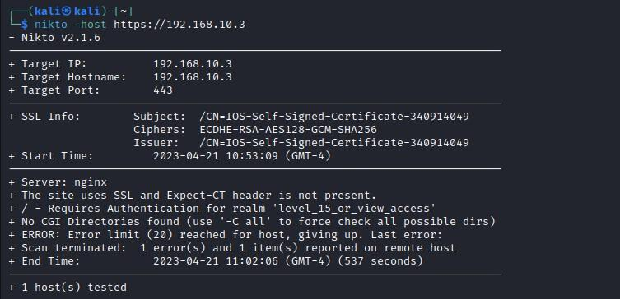
11.18 Execute rights exclusive for CGI/Scripting directory
Requirement:
If CGI or other scripting technology is used, only the CGI/Scripting directory is configured with execute rights. Other directories used or meant for web content do not have execute rights.
Test Scenarios:
Verify Execute Rights for the CGI/Scripting Directory. If any CGI or scripting files are found with executable rights then OEM shall provide its utility.
It is concluded that there is no CGI or scripting file available in the DUT.

Slide 41
THANK YOU

