Slide 1






National Centre for Communication Security
Department of Telecommunications
Ministry of Communications
Government of India
ITSAR - Approach to Security Testing of the Telecom Equipment and it’s Environment
WORKSHOP ON “Essentials Of Telecom Security Testing - A Tools & Testers Perspective- Part 1”
19-June-2024 (Wednesday)

Slide 2


Contents
Overview of Cybersecurity
Importance of Telecom Networks Security
Security Framework for Telecom
Regulatory Framework
ComseC scheme
ITSARs
TSTLs

Slide 3
Overview - Cybersecurity
Cyber security definition as per ITU-T X.1205 (04/2008) comprises of -
Security concepts
Training
Risk management
Policies
Guidelines
Security safeguards
Recovery Strategy
Tools
Security is not one size fit for all situation, the needs are unique and different

Slide 4
End to End Security
End to end security solution for Telecom Networks can be addressed with layered approach. Further security planes can address specific security challenges
Application
Services
Infrastructure
End User Plane
Control Plane
Management Plane

Slide 5

Evolution of security
Information Security
Cyber Security
Network Security
Telecom Network Security

Slide 6
Cyber Security
Protects Internet-connected networks and systems from digital attacks
Ensures the safety of entire digital data
Network Security
Protects directories and files in a network of computers against unauthorized access, misuse and hacking
Ensures the safety of only transmit data
Telecom Network security
Structures, techniques, transport protocols, and security measures used to provide integrity, availability, confidentiality and authentication for transmissions over private and public communication networks
Information Security
Protects Information from unauthorised access, disclosure, modification and use.
Ensures safety of physical data, analog data and digital data
Notes:
https://www.syntaxtechs.com/blog/cyber-security-vs-network-security-clarifying-the-concepts#h1
2. https://www.geeksforgeeks.org/what-is-information-security/

Slide 7
Importance of Telecom Network Security
Cybersecurity is a concern for Telecom Networks as well
Applications are run on top of the layered Networks
Present day communication networks need resilient approach as the scope, variety and complexity of current cybersecurity threats are increasing exponentially
Telecom Service Providers need comprehensive plans to address security concerns
The computing power is moving from Core to Edge making it much more complex to address the security concerns.
The emerging technologies like 5G, 6G, Open RAN etc., are generic in nature with open architecture with Commercially Off The Shelf (COTS) devices.
The Networks are being deployed in Virtual/ Cloud Environment.
5G is the first generation massive Machine Type Communication (mMTC) technology (IoTs, Drones, Smart City Gadgets etc.)
Use cases like Health sector, Power, Agriculture, Industry 4.0, Smart City etc., will heavily depend on 5G and beyond technologies

Slide 8
Security Framework for Telecom
NDCP-2018 proposes to address the security concerns of the country through development of security standards for Telecom Equipment and Devices and permit the deployment of only the safe and certified equipment
To realize this objective, NCCS & TEC have been mandated to develop standards, testing and certification eco system in the country

Slide 9
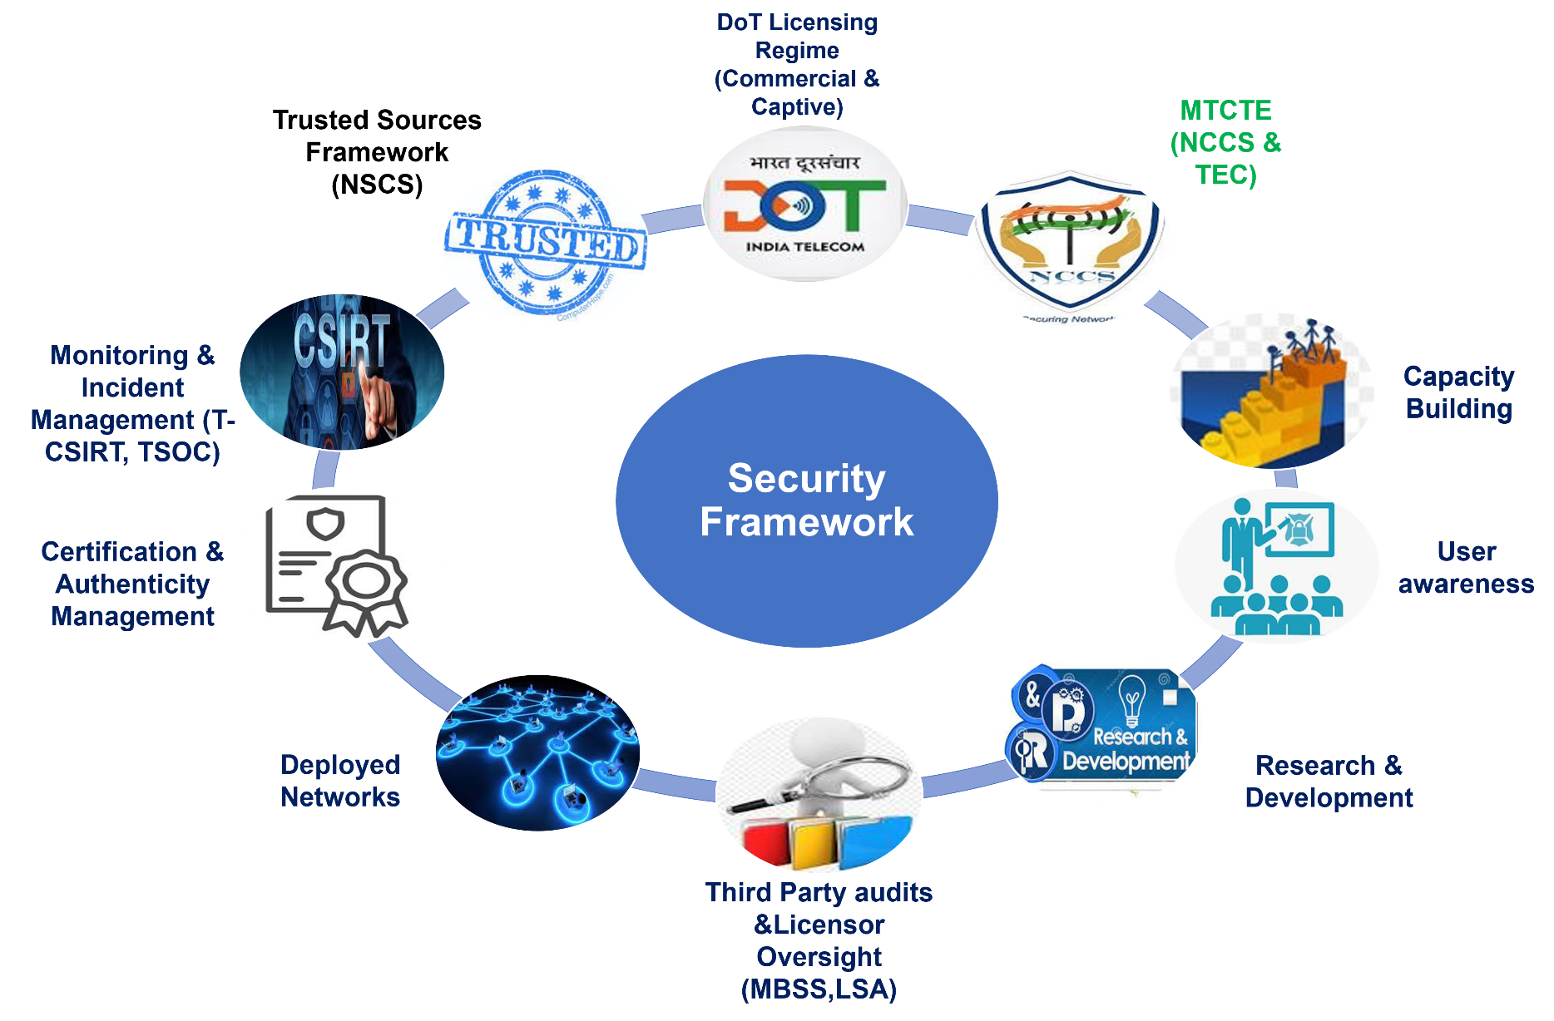

Slide 10


Regulatory Framework
A regulator for Telecom & Broadcasting sectors i.r.o tariff, quality of service, consumer protection etc., with a recommendatory role for introduction of new services, spectrum allocation, and other subjects referred to TRAI by GoI from time to time
Addresses the safety and security of Telecom Networks/ products through its wings -Telecom Engineering Centre (TEC), National Centre for Communication Security (NCCS) and other Field Units (LSA, WMO, CCA etc.)
Frames the standards viz. Essential Requirements (ERs) but also to develop the eco system for testing and certification of Telecom Equipment
Frames the standards viz. Indian Telecom Indian Telecom Security Assurance Requirements (ITSARs) but also to develop the eco system for testing and certification of Telecom Equipment

Slide 11
OBJECTIVES OF NCCS
  Developing Indian Telecom Security Assurance Requirement (ITSAR), Test Schedules Test procedures (TSTP) for Telecom Equipment.
  Designating Telecom Security Testing Laboratories (TSTLs) for testing ITSARs and TSTPs.
  Oversight of testing performed by the designated TSTLs and evaluation of the test results from TSTLs.
  Issuing security certificate for the successfully tested Telecom Equipment.

Slide 12

Communication Security Certification Scheme (ComSeC)

Slide 13
Background
UNIFIED LICENSE
“ The LICENSEE shall induct only those network elements into its telecom network, which have been got tested as per relevant contemporary Indian or International Security Standards e.g. IT and IT related elements against ISO/IEC 15408 standards, for Information Security Management System against ISO 27000 series Standards, Telecom and Telecom related elements against 3GPP security standards, 3GPP2 security standards etc.
The certification shall be got done only from authorized and certified agencies/ labs in India or as may be specified by the Licensor.”

Slide 14
MTCTE SCHEME
In exercise of the powers conferred by section 7 of the Indian Telegraph Act, 1885 (13 of 1885), the Central Government amended the Indian Telegraph Rules, 1951 to insert Rule 528 to 537 in Part XI under the heading Testing & Certification of Telegraph on 05-09- 2017 to be effective from 01-10-2018. The new rules provide that every telecom equipment must undergo prior mandatory testing and certification.
TEC has come out with the Procedure for Mandatory Testing and Certification of Telecommunication Equipment (MTCTE) in Oct’2018 to implement these rules.

Slide 15
MTCTE SCHEME
Essential Requirements specified:
    EMI/EMC
    Safety
    Technical requirements
    Other requirements.
    Security requirements will be handled by a separate unit in DoT (NCCS)
Will be handled by TEC

Slide 16
Communication Security Certification Scheme (ComSeC)
Mandatory testing and certification in respect of Security requirements is being implemented through a Scheme titled ‘Communication Security Certification Scheme’ (ComSeC).
Objectives of the scheme
  To develop country specific security standards, processes and specifications
  To develop testing and certification eco-system.
  To ensure Telecom network elements meet security assurance requirements.
  To ensure compliance of regulatory requirements pertaining to security testing
Notes:
1713950+1006280=

Slide 17
Communication Security Certification Scheme (ComSeC)
The scope of certification covers all types of telecom equipment to be sold in India and to be connected to Indian telecom network, after the date of effect of this scheme, for which ITSAR is available and is in force.
National Centre for Communication Security (NCCS) is responsible for implementation of this scheme.
NCCS is headed by Sr.DDG who is also the Scheme Controller
Sr.DDG/ Scheme Controller is assisted by three divisions each headed by a DDG-
  Security Assurance Standards (SAS) Division
  Security Lab Recognition/Designation (SLR) Division
  Security Certification (SC) Division

Slide 18
Communication Security Certification Scheme (ComSeC)
Scheme provides for:
Preparation and publication of various process documents for the three division of NCCS to carry out their tasks.
Preparation and publication of ITSARs based on country specific security requirements, International Standards and consultations with stakeholders such as OEMs, TSTLs, TSPs, Academic institutes, Industry and Government bodies.
Designation of Labs as TSTLs after satisfactory evaluation of their application and competency of the lab to perform the security testing as per ITSAR. The labs from private and public sector can be designated as TSTLs .
The designation is valid for a period of 3 years.
Notes:
1713950+1006280=

Slide 19
Communication Security Certification Scheme’ (ComSeC)
Scheme also provides for:
Issue of Security Certificate for a Telecom equipment after evaluation of test results submitted by TSTL chosen by the applicant viz., OEM, TSP, Importer etc. Certificate is valid for 10 years or till the equipment is modified, whichever is earlier.
Renewal and modification of certificates issued to TSTLs and the equipment.
Issue of temporary certificates to facilitate quick deployment of software patches like updates and upgrades.
Collection of fee for designation of TSTLs and certification of equipment.
Contd…
Notes:
1713950+1006280=

Slide 20
Communication Security Certification Scheme’ (ComSeC)
Scheme also provides for :
Dispute resolution mechanism for various process under the scheme.
Surveillance to ensure compliance to scheme requirements.
Dealing with non-confirmity and contraventions.
Notes:
1713950+1006280=

Slide 21
Security Testing Framework
Policy Formulation
Research Institute
DRDO
DOT
MeiTY
Other Ministries
SAS Division
ITSAR
Scheme Controller
Sr DDG NCCS
Policy Pronouncement
TSTL Module
Lab Recognition
Certification Division
Security Certification Division
Policy Implementation
Test Lab - 1
Test Lab - 2
Test Lab - 3
Policy Execution
Vendor - Telecom
Vendor - Mobile
Vendor – 4G
MTCTE(SC Portal)
Single Window

Slide 22
Security Certification Process
Preparation and publishing of equipment specific ITSAR.
Designation of TSTLs by NCCS as per designation scheme.
Applicants intending to get their equipment certified will register on MTCTE portal.
After registration, the Applicant can choose a designated TSTL for security testing of his equipment against the applicable ITSAR.
TSTL will conduct the requisite testing under the supervision of a validator from NCCS.
After completion of the testing, test reports will be submitted by the TSTL for evaluation and security certification by NCCS.
On successful evaluation, security certificate will be issued.
Security Certification portal is being developed and existing MTCTE portal is being modified to implement a Single Window System for the implementation of ComSeC scheme.
Notes:
1713950+1006280=

Slide 23
Certification process flow
TEC
Registration of Applicant and Submission of Application form through MTCTE portal
APPLICANT
Processing and scrutinization of Application
Corrective Action by Applicant
Acceptance of Application and documents by TEC
Payment of Applicable fee
Applicant Chooses the designated TSTL in Portal
SC Division
TSTL
TSTL accepts the request
SC Division receives notification of acceptance
Appointment of Validator
Participation by Validator
TSTL starts the security testing against corresponding chosen requirement
Submission of Security testing Report
Evaluation of Report and Acceptance
Issue of Certificate
Notes:
1713950+1006280=

Slide 24
TSTL Designation Process
Prospective TSTL
Has capability to test Telecom equipment
Accredited by NABL for ISO/IEC 17025 (IT & Software discipline)
Submits Application along with supporting documents
Evaluation of Application by DA
Applicant is informed about Discrepancies/ Deficiencies
On-site Assessment
Applicant submits compliance to Discrepancies/ Deficiencies
Final Review
DA issues Designation Certificate

Slide 25
Indian Telecom Security Assurance Requirement (ITSAR)
Notes:
1713950+1006280=

Slide 26
ITSAR PROCESS – Time period
SN | Activity Description | Time in weeks | Remarks
1 | Input Request stage | 6 | Inputs from other Ministries (MHA etc.)
2 | Study of Standards/ Literature |  | Refer national, International standards, product literature available publicly
3 | Pre-Consultation |  | Consult Industry for taking their suggestions on security outline document.
4 | Draft Preparation, use of applicable standards | 4 | Scope the security areas and develop requirements for each area
5 | Stakeholder consultation | 4 | Notify at NCCS, TEC, DOT websites, collate submissions and conduct meeting
6 | ITSAR Technical Committee (ITC) Review | 3 | Circulation, Presentation, incorporating committee recommendations
7 | ITSAR Approval & Publication | 1 | Sr.DDG approval post scrutiny
 | Average Time | 18 weeks | Time required may vary from 16 weeks to 24 weeks depending on type of NE

Slide 27
DETAILS OF ITSARs PUBLISHED
S No | Category | NEs/NFs for which ITSARs published | No of NEs/NFs
1 | 5G Network | User Plane Function (UPF) Session Management Function (SMF) Unified Data Management (UDM) Network Repository Function (NRF) Network Data Analytics Function (NWDAF) Service Communication Proxy (SCP) Security Edge Protection Proxy (SEPP) Access and Mobility Management Function (AMF) Authentication Server Function (AUSF) Network Exposure Function (NEF) Non-3GPP Interworking Function (N3IWF) gnodeB (option 2) gnodeB (option 3,4 and 7) Network Function Virtualization (NFV) Short Message Service Function(SMSF) Unified Data Repository (UDR) Application Function (AF) Binding Support Function (BSF) Policy Control Function (PCF) Unstructured Data Storage Function (UDSF) Network Slice Selection Function (NSSF) Location Management Function (LMF) & Gateway Mobile Location Centre (GMLC) Charging Function (CHF) Equipment Identity Register (EIR) Network Slice Admission Control Function (NSACF) UE Capability Management Function (UCMF( | 26

Slide 28
DETAILS OF ITSARs PUBLISHED
S No | Category | NEs/NFs for which ITSARs published | No of NEs/NFs
2 | CPE | Wi-Fi (CPE) Modem Mobile User Equipment Pluggable (U)ICC Optical Network Terminal (ONT) - PON family Broadband Private Automatic Branch Exchange (PABX) Hybrid Set Top Box | 6
3 | 4G Network | Mobility Management Entity (MME) Serving Gateway (S-GW) PDN Gateway (P-GW) Policy and Charging Rules Function (PCF) Home Subscriber Server (HSS) E-Node – B (4G Access Network Element) | 6
4 | Miscellaneous | IP Router Cell Broadcast centre (CBC) Transmission Terminal Equipment (TTE) Optical Line Terminal (OLT) – PON family Broadband | 4
 | Total |  | 42
Crypto controls applicable for all ITSARs | Crypto controls applicable for all ITSARs

Slide 29
ITSARs IN PROCESS
Draft Under Preparation :
a) e-SIM
b) Network Next Generation Firewall/ IDS/ IPS
c) O-RAN - IITM (O-DU,O-CU,O-RU,RIC)
2. Under Stakeholder Consultation:
a) Lawful interception (LI) – IITB
b) Disaggregated RAN – IITM (CU,DU,RRU)
c) IoT Devices (Smart Meter, Vehicle tracking device, Feedback device and surveillance camera)
d) Revision of Crypto Controls

Slide 30
ITSAR Preparation - Issues
  OEM’s concerns on a few clauses of ITSARs
  OEM support for conducting tests on Device Under Test (DUTs)
  Availability of personnel with required skills at operational level
  Up skilling and Advanced Trainings required
  Need to participate in multi-lateral forums, developer forums to learn advancements in this niche area.
  ITSARs are normally on network function basis. However, for the virtualization and infrastructure layer, Firewall, LIS etc security requirements are also being developed.
  Some of the Network Functions (NFs) are pertaining to specific use cases and are not being deployed immediately by TSPs
Notes:
1713950+1006280=

Slide 31
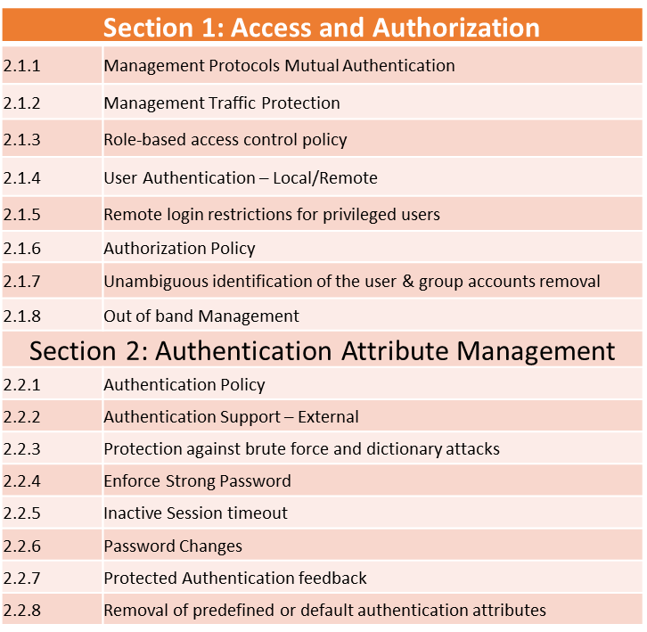
ITSAR Clauses
2.2.9 | Logout function
2.2.10 | Policy regarding consecutive failed login attempts
2.2.11 | Suspend accounts on non-use
Section 3: Software Security
2.3.1 | Secure Update
2.3.2 | Secure Upgrade
2.3.3 | Source code security assurance
2.3.4 | Known Malware and backdoor Check
2.3.5 | No unused software
2.3.6 | Unnecessary Services Removal
2.3.7 | Restricting System Boot Source
2.3.8 | Secure Time Synchronization
2.3.9 | Restricted reachability of services
2.3.10 | Self Testing
Notes:
1713950+1006280=

Slide 32
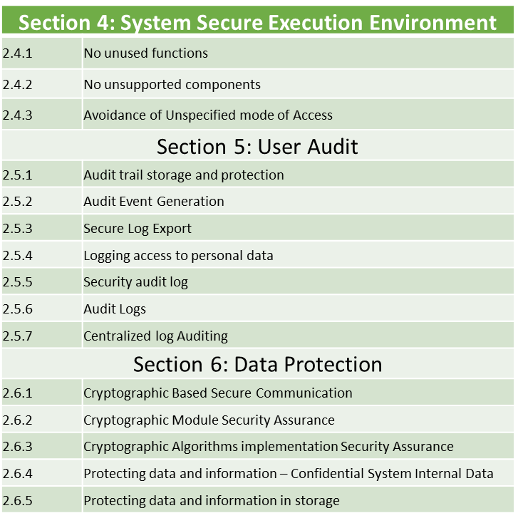
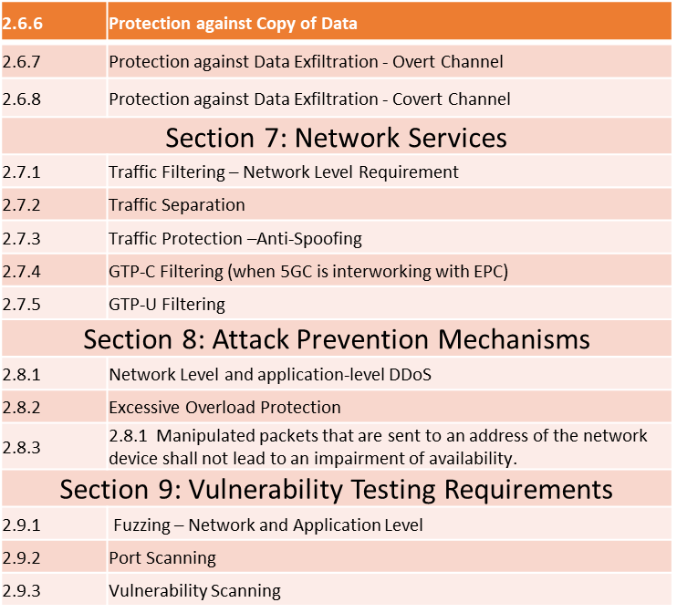
ITSAR Clauses
Notes:
1713950+1006280=

Slide 33
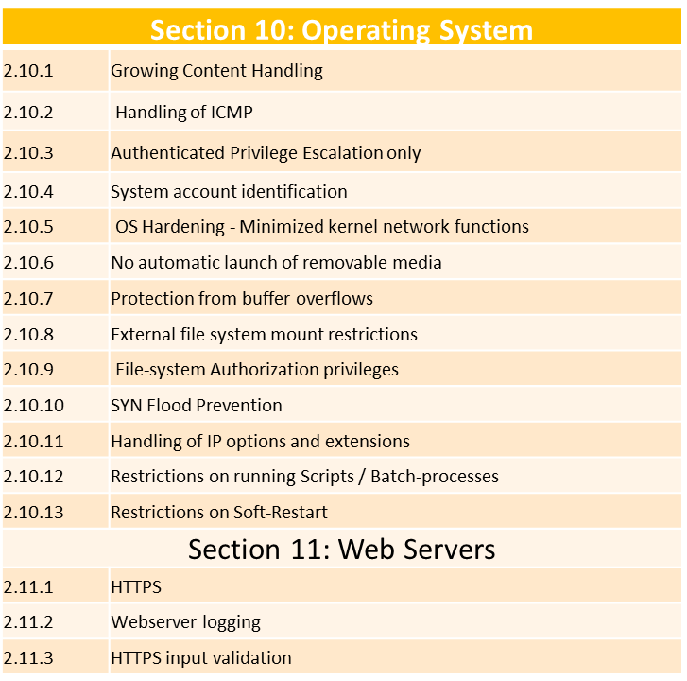
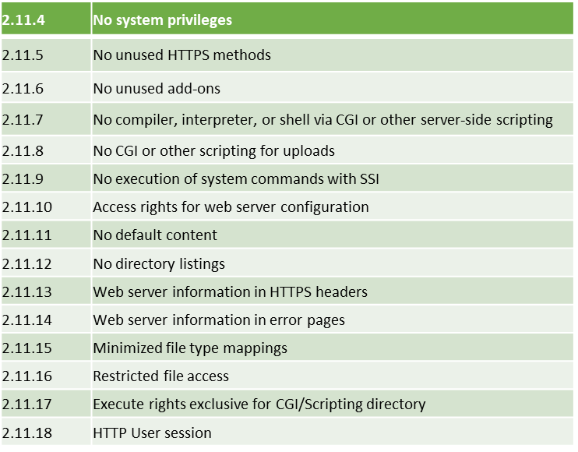
ITSAR Clauses
Notes:
1713950+1006280=

Slide 34
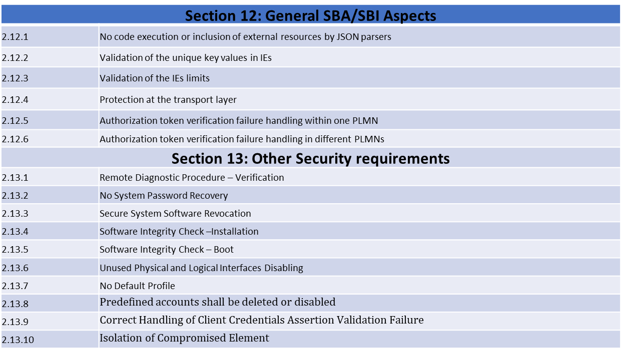
ITSAR Clauses
Notes:
1713950+1006280=

Slide 35
Telecom Security Testing Laboratories (TSTL) Designation Status
Notes:
1713950+1006280=

Slide 36
TSTLs Designated as on date
S.No | TSTL Name | Product Applied for | Date of designation
1 | M/s Accucert Labs LLP , Mumbai | IP Router, Wi-Fi CPE | 30.12.2022
2 | M/s UL India, Mumbai | IP Router, Wi-Fi CPE | 31.08.2023 and 27.12.2023
3 | M/s Granite River Labs(GRL), Bangalore | IP Router, Wi-Fi CPE | 01.12.2023 and 28.02.2024
4 | TUV Rheinland | IP Router , Wi-Fi CPE | 14.2.2024 and May 2024
5 | Deltaphi Labs Pvt Ltd | IP Router, WiFi CPE | 28.03.2024
6 | Matrix Shell Technologies Pvt Limited | 5G SMF | 08.04.2024

Slide 37
TSTLs Designation in progress
S.No | TSTL Name | Product Applied for | Tentative Dates
1 | M/s CN Labs | IP Router and Wi-Fi CPE | June, 2024
2 | M/s GRL | ONT OLT | June 2024 July 2024

Slide 38

https://nccs.gov.in

