Slide 1
Discussion on ICMP related test clauses of ITSAR and associated tools
Umakant,ADET(SAS),NCCS
Harsha Ashturkar , Intern(NCCS)

Slide 2
Abbreviations
TSTL: Telecom Security Test Lab
ITSAR: Indian Telecom Security Assurance Requirement
ICMP: Internet Control Message Protocol
DUT: Device Under Test
ETSI : European Telecommunications Standards Institute

Slide 3
Section 10.2 Handling of ICMP
Requirement :
Processing of ICMPv4 and ICMPv6 packets which are not required for operation shall be disabled on the Network product.
ICMP message types which on receipt lead to responses or to configuration changes are not mentioned in this requirement, but they may be necessary to support relevant and specified networking features. Those must be documented. Certain ICMP types are generally permitted and do not need to be specifically documented.
The Network product shall not send certain ICMP types by default, but it may support the option to enable utilization of these types (e.g., for debugging). This is marked as "Optional" in below table.

Slide 4
Table 1 - Requirements Optional/Permitted

Slide 5
Table 2 : Decisive Requirements
The Network product shall not respond to, or process (i.e., do changes to configuration),
under any circumstances certain ICMP message types as mentioned in table below.

Slide 6
Summary
ICMP packets under Table 1 are allowed for utilisation and are marked optional
or permitted. However, for ICMP packets under Table 2 , only positive test outcomes lead
to certification of the device.
ICMP messages apart from those mentioned in the Table 1 and Table 2; which lead to response from DUT or cause configuration changes in the DUT must be documented.

Slide 7
Available Guidelines

Slide 8
ETSI TS 133 117 V14.2.0 (2017-07) Rel 14 recommendations
Message/packet !=(malformed, irrelevant)
Execution steps:
The tester sends samples of the applicable ICMP messages from the tester machine to the network product and verifies by appropriate means that
- the messages are dropped on receipt by the network product (e.g. by means of appropriate firewall rules),
- or no response is sent out towards the test machine,
- or there are other means ensuring that the ICMP messages cannot trigger a response/ cannot lead to configuration changes.
- or the network product's applicable system configuration remains unchanged upon receipt of the messages.
The test for this requirement can be carried out using a suitable tool or manually by performing the steps described. If a tool is used then the tester needs to provide evidence, e.g. by referring to the documentation of the tool, that the tool actually provides functionality equivalent to the steps.

Slide 9
Available open source tools
Scapy
Hping3
Nmap-nping

Slide 10
Case Study: Nping

Slide 11
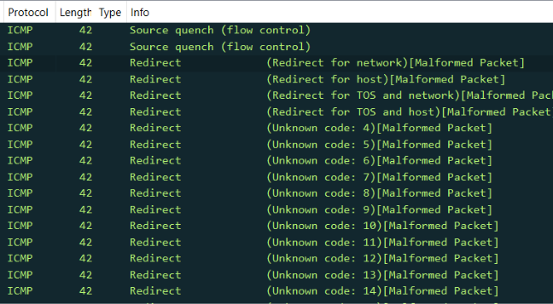
Case Study: Malformed Packet
Malformed Packet - causes
Incorrect Packet Length
Truncated Packet
Invalid Checksums
Incorrect Protocol Headers
Unexpected Payload Data
Mismatched Protocol Layers
Bit Errors (Corruption)
Packet Fragmentation Issues
DUT behaviour
Drops or logs with destination unreachable
Silently drops, etc.
The crafted(scapy) ICMP packet is malformed.

Slide 12
Case Study: Well-formed but ineffective
The crafted packet is well-formed but is ineffective.

Slide 13
Peeling back the layers…
redirect_packet=
IP(src=Test Machine IP, dst= DUT IP)/
ICMP(code, gateway=new gateway)/
IP(src=DUT IP, dst=redirect target IP address)
Outer IP header
ICMP Header
Original/Inner IP Header

Slide 14
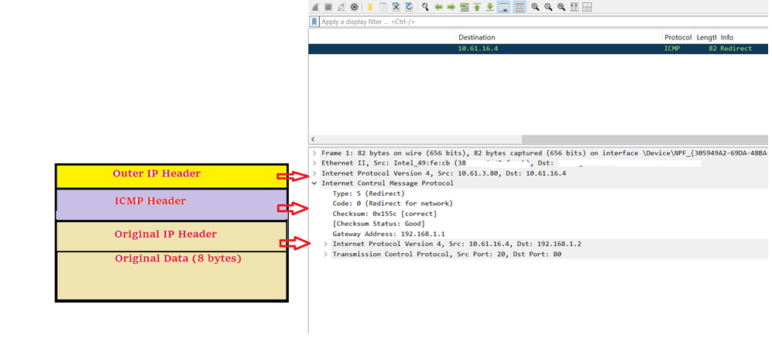
Redirect Packet - structure

Slide 15
Challenges before us
Unavailability of test tool/expertise for sending relevant well-formed ICMP packets.
Malformed packets are straightaway dropped by most of the DUTs and thus do not actually test the DUT, though it leads to a successful test performance.
NCCS evaluator has to understand scripts/software used for packet crafting.
Multi-disciplinary skills are required to perform tests or interpret the test results.

Slide 16
A solution…
ICMP test tool v1.0
ICMP messages as per the TCP /IP stack.
Automates the full process of testing and report generation.
Algorithm is pre decided- brings uniformity in analysis of test results.
Demonstration …

Slide 17
Table 2 Implemented Algorithm
S. No | Type (IPv4/v6) | Description | Send | Respond to | Process (i.e. do changes to configuration) | Algorithm*
1 | 5/137 | Redirect | NA | NA | Not Permitted | Check for routing table changes/configuration
2 | 13 | Timestamp Request | NA | Not Permitted | NA | Check for timestamp reply
* Not limited to the mentioned.

Slide 18
Table 2 Implemented Algorithm
S. No | Type | Description | Send | Respond to | Process (i.e. do changes to configuration) | Algorithm
3 | 14 | Timestamp Reply | Not Permitted | NA | NA | Send an anomalous time stamp reply and compare DUT configuration.
4 | 133 | Router Solicitation | N/A | Not Permitted | Not Permitted | Send RS, Listen for RA.
5 | 134 | Router Advertisement | N/A | Not Permitted | Not Permitted | Send RA. DUT is expected to DROP RA packet. Check esp. for Default Gway. changes in config.

Slide 19
Way forward
TSTL generates the report using the ICMP test tool v1.0.
TSTL submits the report along with the hash generated on the GUI.
OEM declares optional ICMP messages used for debugging in the consolidated product information sheet.

Slide 20
Limitations of ICMP test tool v1.0
For estimating time changes in the DUT, the DUT should support NTP.
For checking changes in device configuration, secure shell access is required.

Slide 21
Suggestion? Questions? 📧uma.kant91@gov.in Thank you.

